Slide 1
RCE-8836192 Special Topics in Radio and Communications Engineering I
Lecture 3: Long-distance WiFi over Sea
3.1 System Structure
3.2 Communication Devices
3.3 Communication Protocol
3.4 Network Architecture
3.5 Test Results
Ref: Unni et al., "Peformance measurement and analysis of long range
Wi-Fi network for over-the-sea communication", Int. Workshop Wireless
Network Meas. Experi., 2015.

Slide 2
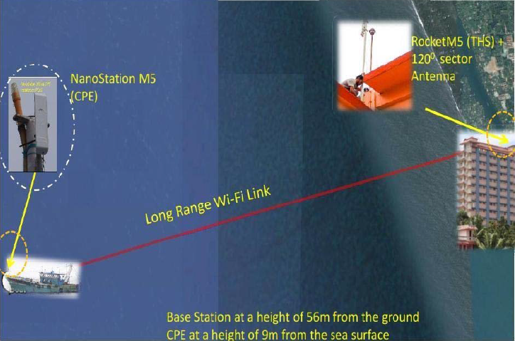
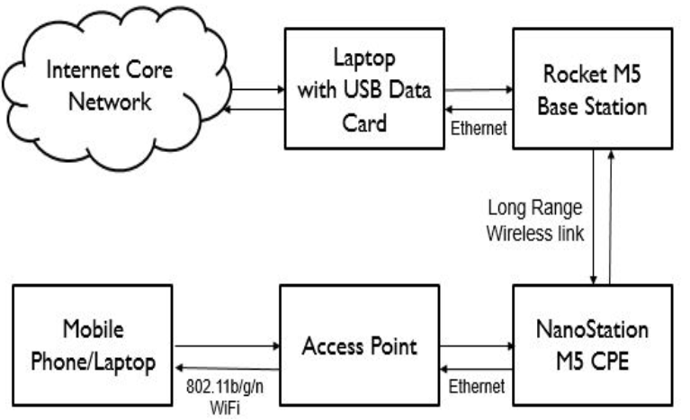
3.1 System Structure

Slide 3
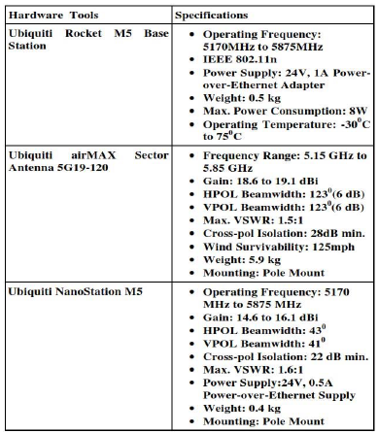
3.2 Communication Devices

Slide 4
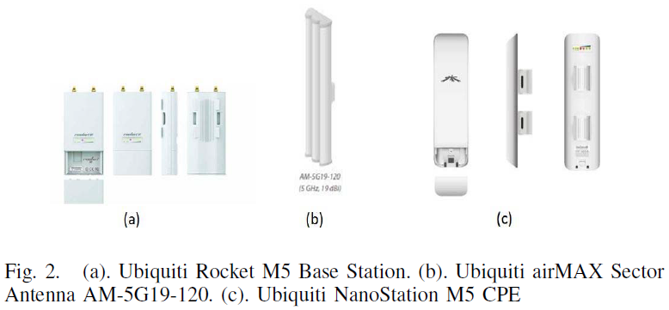
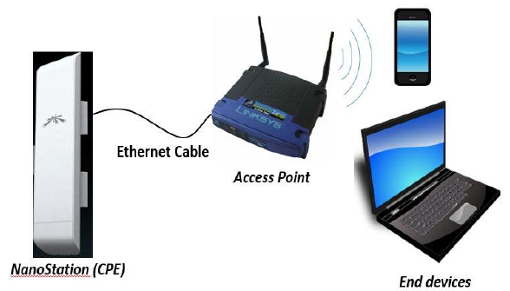

Slide 5
3.3 Communication Protocol
Ubiquiti's TDMA airMAX protocol:
- Send and receiver data using pre-designated time slots scheduled by an intelligent AP
controller (the Rocker M5 = access point)
- Support up to 100 clients
- NanoSation M5 = station
- Run on airOS and airView
Device Name, Wireless Mode, Network SSID, Frequency, Channel Number,
Channel Width, MAC ID

Slide 6
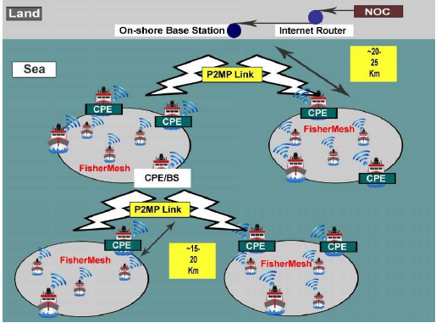
3.4 Network Archtecture
802.11n : CSMA/CA
Long-range WiFi 802.11n: TDMA MAC

Slide 7
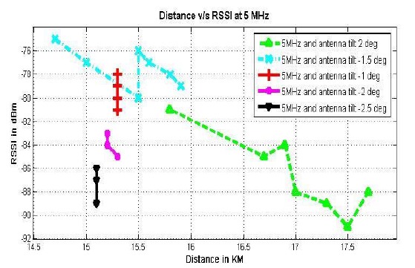
3.4 Test Results
- RSSI (received signal strength indicator)

Slide 8
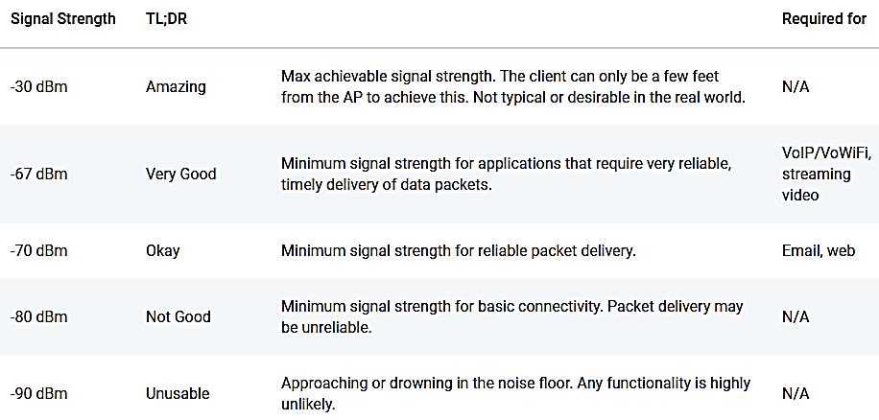
- RSSI (received signal strength indicator)

Slide 9
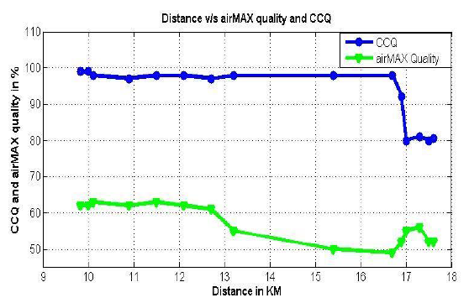
- CCQ (wireless client connection quality): 100% = perfect link state
- airMAX quality (AMQ): number of retries (reconnection) + quality of physical link

Slide 10
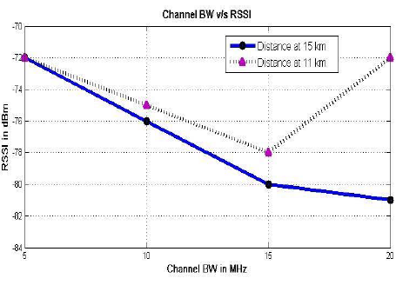
- HD video (720, 1080p) : 5 Mbps
- 4K streaming: 25 Mbps
- 802.11ac : 11-54 Mbps, 150 Mbps for single-stream
- 802.11ax WiFi 6: 6.79 Gbps for 8 streams, 1024 QAM ( spectral eff. 15.6 bps/Hz)

Slide 11
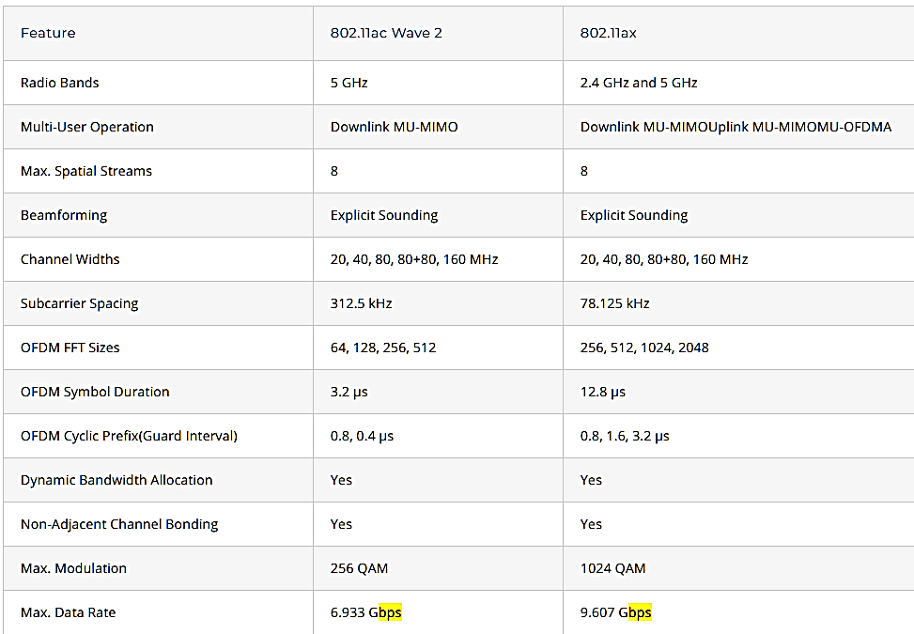
- 802.11ac Wave 2 and 802.11ax WiFi 6 spec:

Slide 12
RCE-8836192 Special Topics in Radio and Communications Engineering I
Lecture 3: Long-distance WiFi over Sea

