Slide 1
RCE-8836192 Special Topics in Radio and Communications Engineering I
Lecture 9: Radiowave Propagation
9.1 Fequency Bands and Radiowave Propagation
9.2 Free-Space Path Loss
9.3 Radiowave Propagation over the Earth
9.4 Propagation Model for Land-Mobile Communication

Slide 2
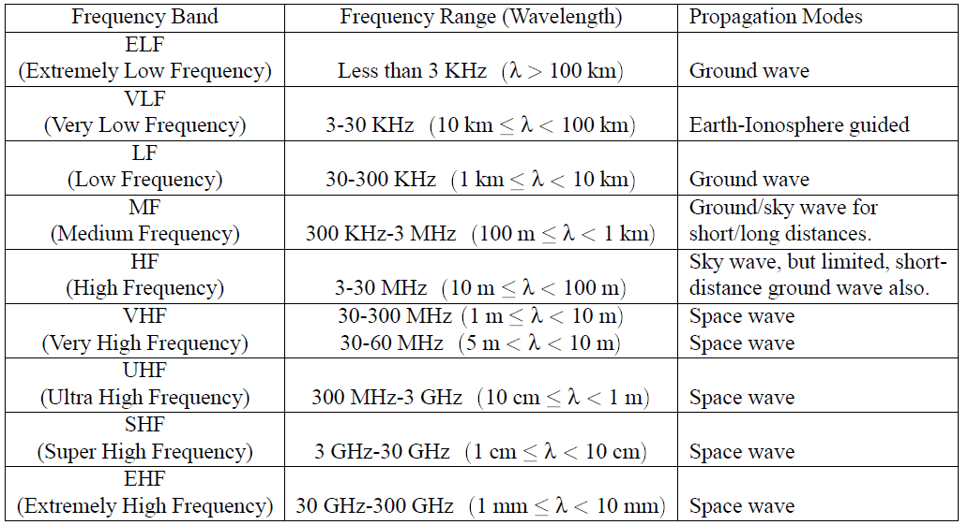
9.1 Frequency Bands and Radiowave Propagation Modes

Slide 6
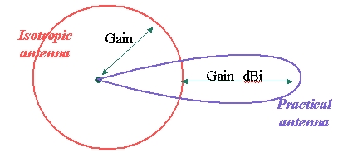
9.2 Free-Space Path Loss
EIRP (effective isotropically radiated power)

Slide 7
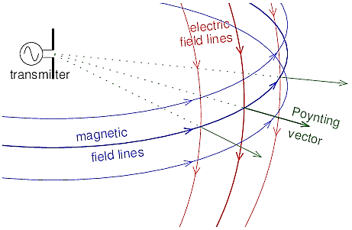
Electric field and magnetic field strenth

Slide 8
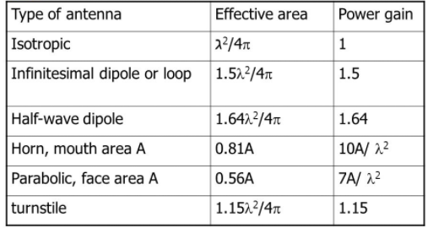
Effective Area of An Antenna

Slide 9
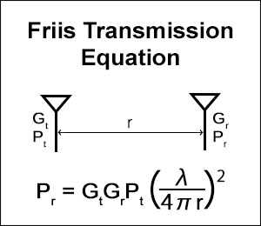
Power at Receiving Antenna

Slide 10
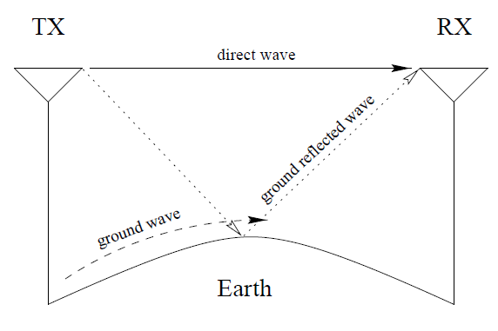
9.3 Propagation over the Earth
- Direct wave
- Reflected wave: almost perfect reflection
- Ground wave

Slide 11
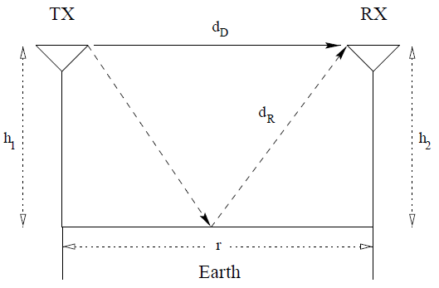
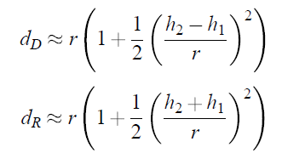

Slide 12
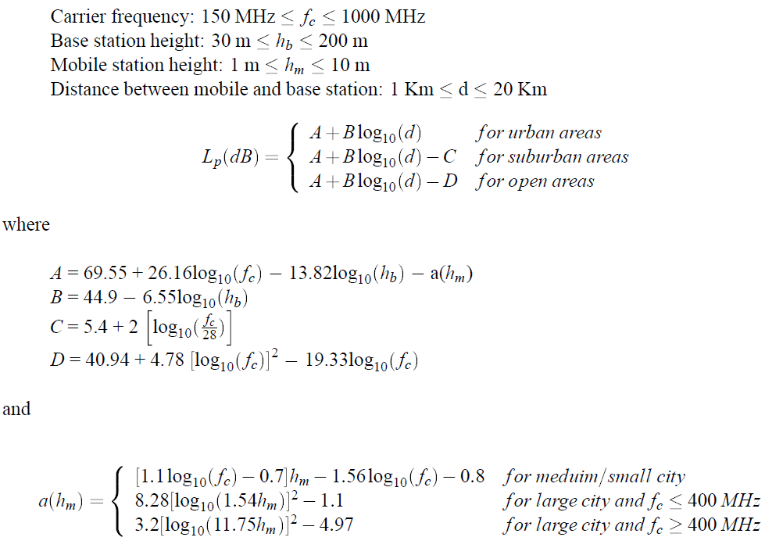
9.4 Propagation Model for Land-Mobile Communication
Hata model:
- Empirical model based on measurements

Slide 13
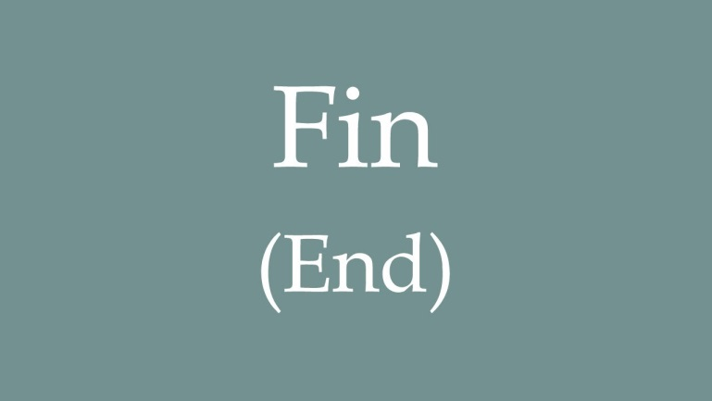
RCE-8836192 Special Topics in Radio and Communications Engineering I
Lecture 9: Radiowave Propagation

