Slide 1
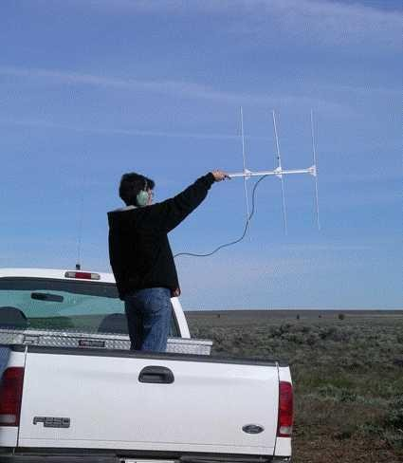
Radio Direction Finding
Gloucester County NJ Amateur Radio Club Jim, N2GXJ
1

Slide 2
What is RDF?
• RDF – Radio Direction Finding
– Determining the direction from which a received radio signal was transmitted.
• Technology has changed over the decades
• Essential elements of the techniques have not
• Success is still largely up to the skill of the RDF equipment operator
2

Slide 3
When RDF?
• Searching for sources of radio interference
• Localizing non-authorized transmitter
• Identification of transmitters, known and unknown
• Dealing with spread spectrum techniques, especially in wireless communications
• Military and security forces
• Civilian search and rescue
• Wildlife tracking
• Radiosport!
3

Slide 4
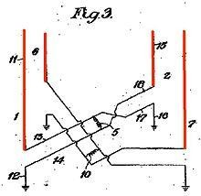
History
• DF technique is as old as radio
• Heinrich Hertz (1888) experiments with decimetric waves found antenna directivity
• Early patents
– Stone, 1902
– Forest, 1909
– Belini and Tosi, 1909
– Adcock, 1919
4

Slide 5
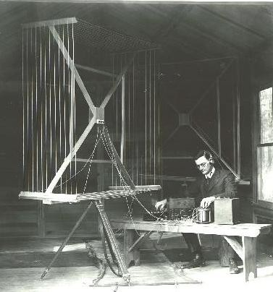
History -WWI
• DF widely used to pinpoint enemy
forces during WWI
• “Radio Compass”, prototype for
U.S. Navy 1916
• Passive technology, listen in on
large military forces keeping in
contact with their headquarters
• Manual RDF techniques
– Rotatable antennas
• RF propagation challenges,
groundwave, skywave, multi-path,
fading, polarization changes,
non-white external noise, seasonal
and time-varying ionospherics,
(don’t we know!)
Kensington Maryland field station, circa 1919, NIST Photographic Collection
(http://museum.nist.gov/panels/gallery/radiodf.html)
5

Slide 6
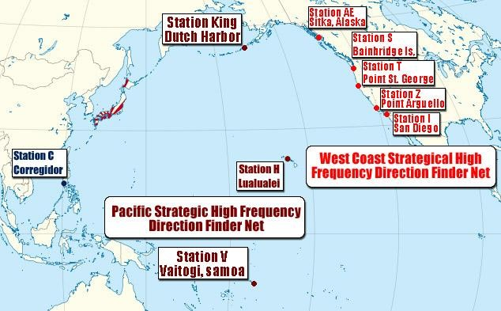
History - WWII
• Accuracy improvement – HF/DF Nets
– Multiple RDF stations operating together as a “net”
– Each try get directional fix on callsign heard, noting time and frequency, then coordinate with others
– Intercept lines drawn on map for all sites that got a fix on target
Ref: http://www.researcheratlarge.com/Pacific/RDF/
6

Slide 7
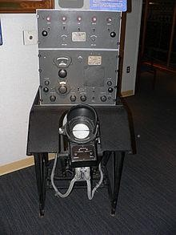
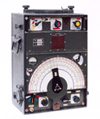
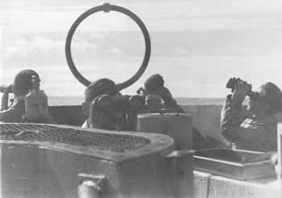
WWII, RDF Stories
• Pearl Harbor
– As shown in movie “Tora Tora Tora”, Japan fleet used Honolulu
broadcast station as an over-the-horizon beacon for attack on
Pearl Harbor
– Regular Japanese carrier radio operators kept back in Tokyo,
generating false traffic
• their unique styles recognized and located as being in home islands
U.S. Navy DAQ (WWII)
• Secret Transmitters
– British Radio Security Service – up to 1700 volunteer interceptors (radio amateurs) recruited to detect illicit transmissions
– Similar efforts in Europe by the Germans to locate resistance groups
• D-day Deceptions
– Operation Fortitude, with (fake) First US Army Group, led by
George Patton. Radio trickery helped convince Germans real plan for
invasion in Calais, not Normandy.
German EP2a
• U-boats
– U-boat “loop” antenna technology, used in hunting Allied shipping (ref: http://uboat.net/articles/51.html)
– British ships outfitted with new automatic “HuffDuff” very
effective in tracking and hunting short duration German
submarine transmissions, helped turn the tide of shipping losses
German U-67 DF Antenna
7

Slide 8
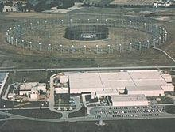
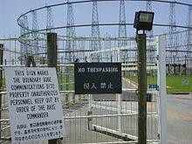
Cold War
• After WWII
– From 1950’s, US adapted German Wullenweber antenna systems for use in Vietnam, cold-war eavesdropping (FRD-10, AN/FLR-9)
– Russians deployed similar (Krug), early use included tracking Sputnik
– OUTBOARD HF/DF systems standardized on U.S. Navy vessels
• New and Improved Technologies
– Automatic signal search and analysis
– Combined active/passive systems (e.g. Over the horizon HF radar)
Refs: http://www.answers.com/topic/radio-direction-finding-equipment AN/FLR-9, ref: http://en.wikipedia.org/wiki/Wullenweber http://www.engineeringradio.us/blog/2010/10/how-the-cold-war-was-won
8

Slide 9
Modern Era
• Military (still)
• Search and Rescue
• Wildlife Tracking
• Spectrum enforcement
• Amateur RDF

Slide 10
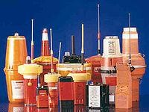
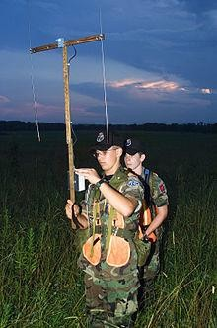
Search and Rescue
• Distress Radio Beacons
• Cospas-Sarsat (satellite) compatible
beacon frequencies
– Maritime (EPIRBs)
– Aircraft (ELTs)
– Personal (PLBs)
– 406.025 Mhz (digital burst, satellite)
– 121.5 MHz (analog, short range homer)
– 243. Mhz (old, phased out since 2009)
• What about APRS(average packet
delivery radio system) ?
• Other systems, not so standard
– 457 kHz, Avalanche transceiver
– 216-217 MHz, LoJack ‘Safetynet’ & law enforcement tracking devices
– Has distress packet type, but not guaranteed & not satellite compatible

Slide 11

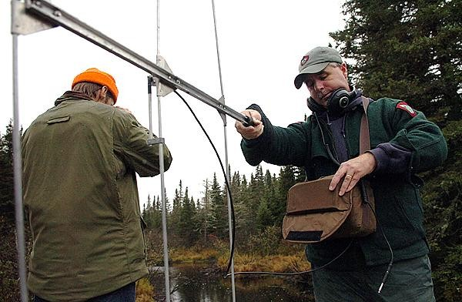
Wildlife Tracking
• Tracking
– Micro-transmitters, collars, tagging technologies
– RDF techniques (fixed-wing, mobile, and on-foot)
• Studies
– Migration patterns
– Population studies
• Volunteer opportunities?

Slide 12
RDF Technologies
• Spectrum Enforcement
– If can’t ID interfering signal by demodulation, or signal analysis, need radiolocation to locate source
• Radiolocation Technologies
– Manual Techniques
– Doppler DF
– Watson-Watt
– Time difference of arrival, SRDF(super resolution DF)

Slide 13
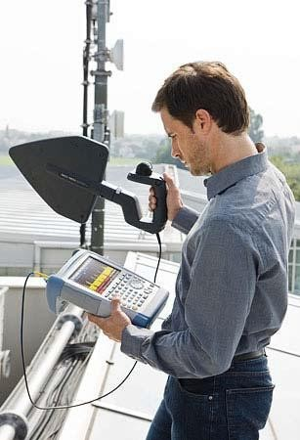
RDF Technology
• Manual Techniques
– Use of receiver and hand-held directional
antenna
– Antenna is moved/rotated to find
directions of min and max signal strength,
usually based on signal amplitude
– “Home-in” on signal by moving in
direction of signal, then sweep to test
possible locations in suspect area
– Can also plot bearing lines to triangulate general transmitter location
– Limitations: highly dependent on skill of operator, accuracy poor at distance,
difficult to get bearing on short duration
signals, difficult to get bearing on
frequency agile signals
Rohde & Schwarz portable monitoring & RDF

Slide 14
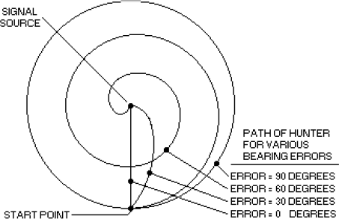
Homing-in by Bearing
• If mobile, can take bearing, follow it for a bit, then repeat
• Not always shortest path

Slide 15
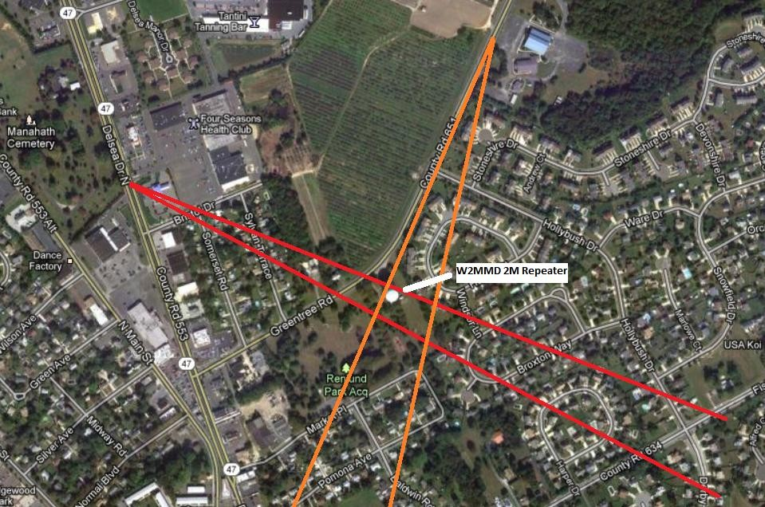
Triangulation
• Narrow search area by triangulating lines of bearing
– Take directional measurements from several locations
– Plot bearings on a map, narrow search to where bearings intersect
– Directional uncertainty at distance, progressively smaller hunt areas
– Max signal strength (S-meter) when close, attenuate to avoid overload

Slide 16
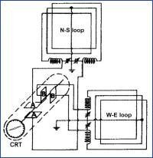
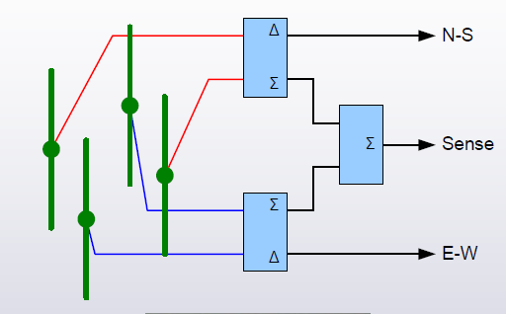
Watson-Watt
• Amplitude comparison
technique, developed after WWII, using crossed loop, or Adcock antennas
• Enabled real-time RDF, even for short duration signals
• Difference signals from N-S, and W-E used to deflect electron beam on CRT
• Basic Adcock/Watson-Watt design is basis of many
systems today

Slide 17
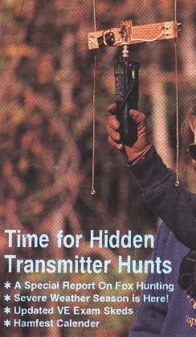
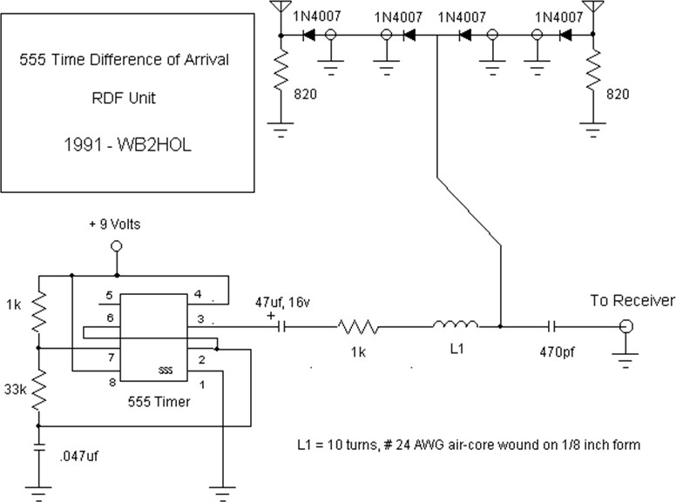
TDOA
• Time difference of arrival (TDOA)
• Works on detecting a phase difference, not amplitude difference
– Useful for close-in work, when amplitude schemes overload
• FM tone when signal not arriving at antennas at same time
– Turn antenna unit until find null (180 degree ambiguity)

Slide 18
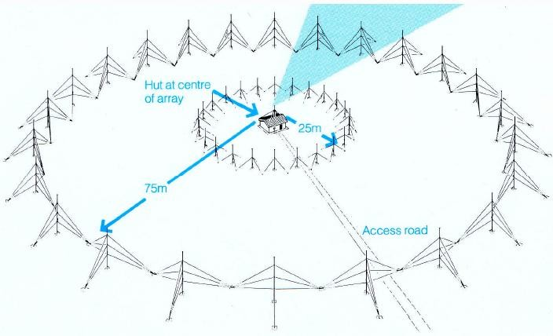
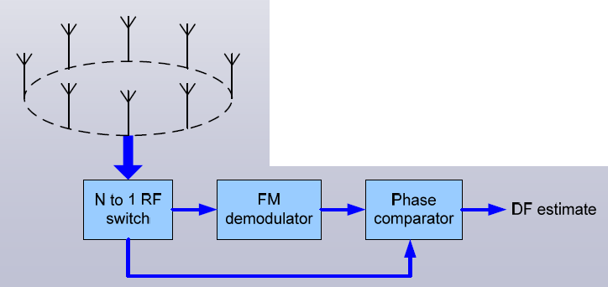
Doppler DF
• Doppler shift
– Circular array, electrically rotating antenna
(goniometer = 각도계, CDAA=cirularly disposed antenna array)
– Single receiver, rotational FM tone demodulated
– Closer to signal: frequency shifts up, away: shift down
– Phase offset of recovered tone vs. original is direction of arrival

Slide 19
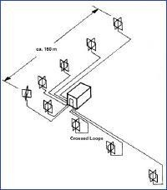
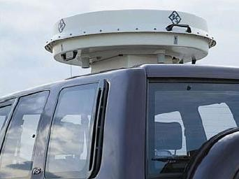
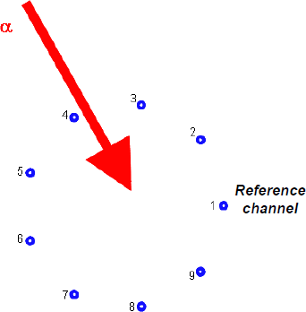
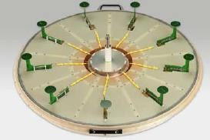
Correlation Interferometer(CI) RDF
• Interferometry first used in radio astronomy
• Measures angle of incident wavefront at multiple elements
• Relies on digital signal processing for sensor array processing
• Electrically small active or passive elements, wideband performance
• Number of elements in CI antenna varies (5-9 typical)

Slide 20
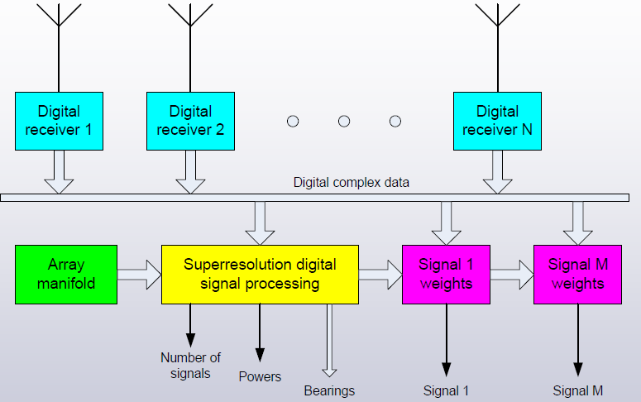
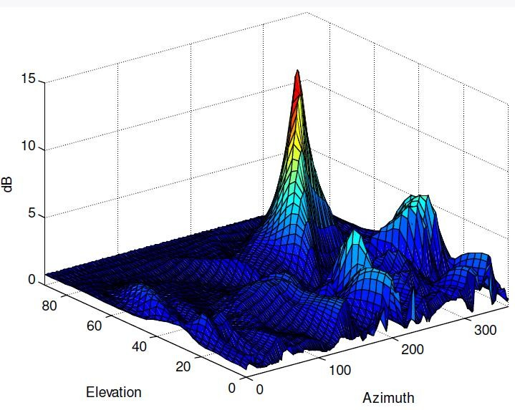
TDOA / Super-resolution / SRDF
• Taking advantage of software - digital signal processing techniques
– Since 1990’s, order of magnitude increase in resolution
– Increased DF accuracy
– Azimuth and elevation DF
– Simultaneous DF of multiple co-channel signals
– Operation with very few data samples (MUSIC, Capon, ESPRIT algorithms)
– Adaptive beam forming for signal separation (null steering)
– Not fixed to a particular array geometry (array manfold from stored
calibration function)

Slide 21
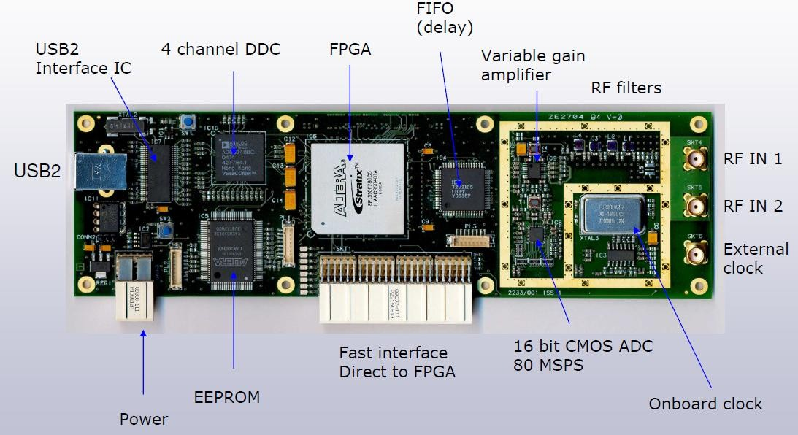
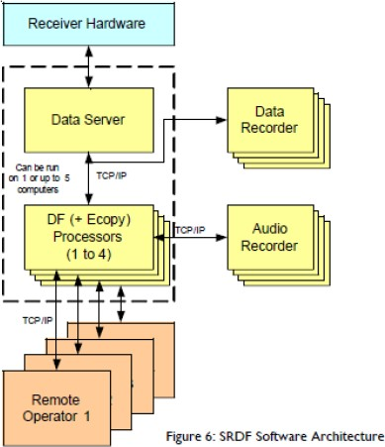
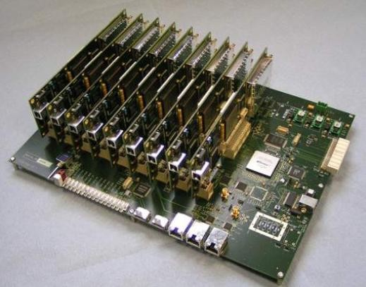
Digital receivers
• Near instantaneous signal acquisition
• No calibration required
• No need for multiple coherent local oscillators
• Supports DF on short duration / frequency hopping signals
• Supports reconstruction of frequency hoppers
• Broadband beam forming without need for large coaxial cable delay lines
• N channels provides 10logN dynamic range enhancement
Ref: http://www.g4axx.com/HF_Radio_Direction_Finding.pdf

Slide 22
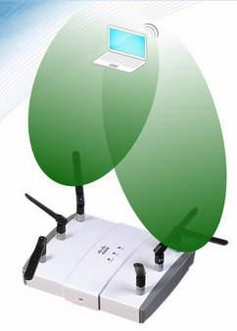
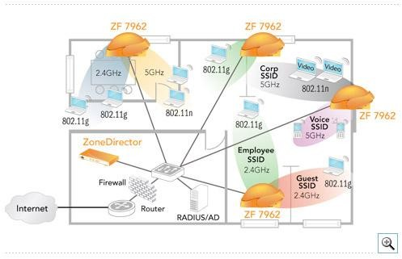
Digital Beam forming
• You might have digital beam forming equipment in your home or office right now!
• 802.11n WI-FI since 2009 (e.g. Cisco Aironet, Ruckus 7962)
– Adaptive antenna technology
– Null steering for automatic interference mitigation

Slide 23
Radio Direction Finding
• Thank you! See you!

