Slide 1
Frequency Bands

Slide 2
I. Frequency Bands
1. ITU bands
2. ECM bands
3. EU/NATO radio bands alternative
4. IEEE radio bands
5. Waveguide frequency bands

Slide 3
1. ITU (International Radio Union) bands
1 (ELF) 3-30 Hz
2 (SLF) 30-300 Hz
3 (ULF) 0.3-3 kHz
4 (VLF) 3-30 kHz
6 (LF) 30-300 kHz
7 (MF) 0.3-3 MHz
8 (HF) 3-30 MHz
9 (VHF) 30-300 MHz
10 (UHF) 0.3-3 GHz
11 (SHF) 3-30 GHz
12 (EHF) 30-300 GHz
13 (THF) 0.3-3 THz

Slide 4
2. ECM bands (EU/NATO/US)
A 0 – 250 MHz
B 250-500 MHz
C 0.5-1 GHz
D 1-2 GHz
E 2-3 GHz
F 3-4 GHz
G 4-6 GHz
H 6-8 GHz
I 9-10 GHz
J 10-20 GHz
K 20-40 GHz
L 40-60 GHz
M 60-100 GHz

Slide 5
3. EU/NATO radio bands alternative
I 100-150 MHz
G 150-225 MHz
P 225-400 MHz
L 0.39-1.55 GHz
S 1.55-3.90 GHz
C 3.9-6.2 GHz
X 6.2-10.9 GHz
K 10.9-36.0 GHz
Ku 10.9-20 GHz
Ka 20-36 GHz
Q 36-46 GHz
V 46-56 GHz
W 56-100 GHz

Slide 6
4. IEEE radio bands
HF 3-30 MHz
VHF 30-300 MHz
UHF 0.3-3 GHz
L 1-2 GHz
S 2-4 GHz
C 4-8 GHz
X 8-12 GHz
Ku 12-18 GHz
K 18-27 GHz
Ka 27-40 GHz
V 40-75 GHz
W 75-110 GHz
mm 30-300 GHz

Slide 7
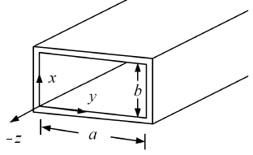
5. Waveguide frequency bands
R 1.70-2.60 GHz
D 2.20-3.30 GHz
S 2.60-3.95 GHz
E 3.30-4.90 GHz
G 3.95-5.85 GHz
F 4.90-7.05 GHz
C 5.85-8.20 GHz
H 7.05-10.10 GHz
X 8.2-12.4 GHz
Ku 12.4-18.0 GHz
K 15.0-26.5 GHz
Ka 26.5-40.0 GHz
Q 33-50 GHz
U 40-60 GHz
V 40-75 GHz
W 75-110 GHz
F 90-140 GHz
D 110-170 GHz
G 140-220 GHz
Y 325-500 GHz

Slide 8
II. ITU Regions
1. ITU
2. ITU radio spectrum regions

Slide 9
1. ITU (International Telecommunication Union)
- 국제전기통신연합
- 유엔 산하 기구. 전기통신 관련 국제협력
- ITU-R (무선통신): 1927년 출범
- ITU-T (표준화): 1956년 출범
- ITU-D (개발): 1992년 출범
- ITU Telecom (행사): 1971년 출범. ITU Telecom World 2011 (40주년)
- WRC (규정, 협약): World Radiocommunication Conferences
3-4년 주기로 개최. 주파수 사용, 정지/비정지 위성궤도 관련 국제
규약의 심의, 개정, 제정

Slide 10
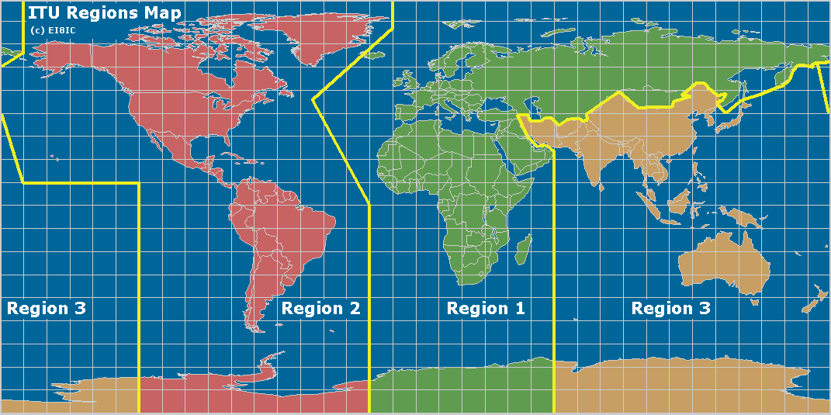
2. ITU radio spectrum regions

Slide 11
III. Frequency per Applications
1. Broadcast frequencies
2. GNSS frequencies
3. Aeronautical telemetry frequencies (WRC'07)

Slide 12
1. Broadcast frequencies
Longwave AM Radio 148.5-283.5 kHz
Medium Wave AM Radio 530-1710 kHz
Shortwave AM Radio 3-30 MHz
FM Radio
87.5-108.0 MHz (ITU Region I)
87.9-107.9 MHz (ITU Region II)
76.0-90.0 MHz (Japan)
TV 54- 698 MHz
Americas, Caribbean, South Korea, Taiwan, the Philippines
54-88 MHz VHF Low-band (Band I), ch. 2-6
174-216 MHz VHF High-band (Band III), ch. 7-13

Slide 13
1. Broadcasting frequencies
Band I 47-88 MHz
Band II 87.5-108.0 MHz
Band III 174-250 MHz
Band IV 474-602 MHz (BBC)
Band V 614-854 MHz (BBC)
Band VI 11.7-12.7 GHz

Slide 14
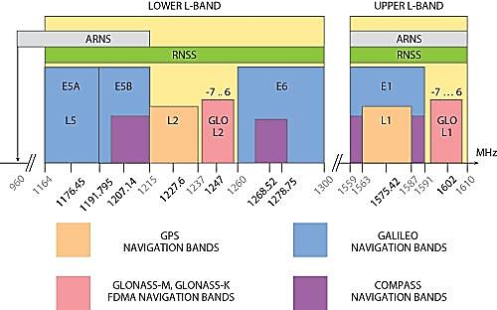
2. GNSS frequencies

Slide 15
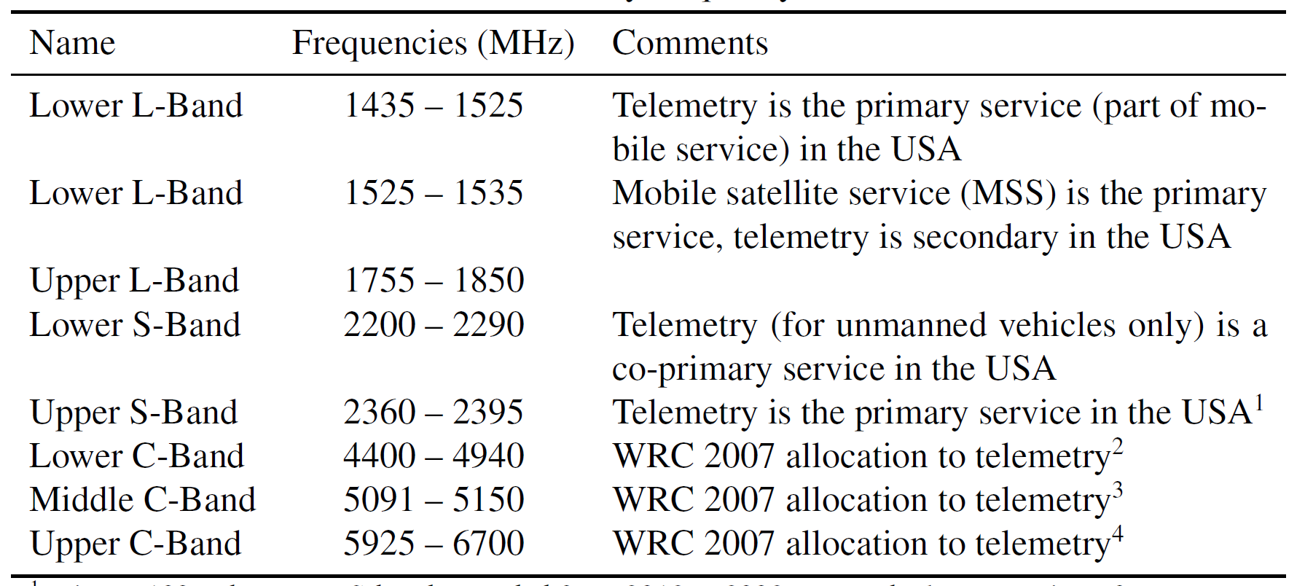
3. Aeronautical telemetry frequencies (WRC'07)
Ref: M. Rice, DTIC, AD578383

Slide 16
4. Short range devices (SRDs)
A) All
3.155-3.195 MHz Hearing aids
6.765-6.795 MHz ISM, non-specific
13.553-13.567 MHz ISM, RFID, NFC
26.957-27.283 MHz Citizen's band
315-316 MHz China
40.669-40.700 MHz ISM, non-specific
260-470 MHz Canada
402-405 MHz ISM, Active medical implants
433.050-434.790 MHz ISM, LPD433
863-870 MHz SRD860
902-928 MHz Canda
915-928 MHz Australia

Slide 17
2.400-2.4835 GHz Wi-Fi, amateur radio
5.725-5.875 GHz ISM
5.795-5.805 GHz Automatic toll collection
5.805-5.815 GHz Automatic toll collection
76-77 GHz Automotive long range radar (LRR)
61.0-61.5 GHz ISM
122-123 GHz ISM
244-246 GHz ISM

Slide 18
B) Global license-free SRD frequencies in MHz
Europe: 433.05-434.79, 868.0-870.0, 863.0-870.0
U.S.: 260-470, 902-928
Canada: 260-470, 902-928
Japan: 426.0375-426.1125, 429.175-429.7375
China: 315.0-316.0, 430.0-432.0
Austalia: 433.05-434.79, 915-928

Slide 19
C) 대한민국 소출력 무선기기
코드없는 전화기: 3mW = 46.510-46.970MHz/49.695-49.970MHz
10mW = 914.01-914.9875MHz/959.0125-959.9875MHz
특정 소출력: 10mW = 219.000-224.125MHz, 10mW = 424.700-424.950MHz
무선마이크:
3mW: 74MHz 대역
1mW: 106-107MHz 대역
3mW: 220MHz 대역
10mW: 740-750MHz 대역
10mW: 928-929MHz 대역
무선조정용:
10mW: 173MHz 대역, 산업용(중장비, 크레인)
5mW: 173MHz 대역, 447MHz 대역, 자동문 제어, 자동차 시동
5mW: 311MHz 대역, 자동차 시동
안전시스템:
10mW: 447MHz 대역, 도난/화재 경보장치

Slide 20
영상전송용:
10mW = 2.410-2.470GHz
시각 장애인 유도신호용:
235MHz: 고정장치, 10mW
358MHz: 휴대장치, 10mW
ISM 대역
13.560MHz: 교통카드, 모형기기 무선조정
27.120MHz: 생활무선국, 모형기기 무선조정
40.690MHz: 모형기기 무선조정
915MHz: 국가 사용
2.450GHz: 아마추어, 이동체 식별장치, 무선LAN
5.800GHz: 아마추어, 방송중계, 군레이더, 무선LAN
24.125GHz: 아마추어, 고주파 이용설비

Slide 21
국내 허가/신고 불필요 무선주파수
322MHz 미만: 500μV/m 이하. 15MHz 이하에서는 6π/λ를 곱함.
322MHz 이상 10GHz 미만: 35μV/m 이하
10GHz 이상 150GHz 미만: 3.5f μV/m, f(GHz), 500μV/m 초과시 500μV/m로 한다.
150GHz 이상: 500μV/m 이하

Slide 22
US Amateur Radio Frequency Allocation
송신출력 상한선: 1.5 kW PEP, 200 W PEP on HF bands
160-m 1.8-2.0 MHz
80-m 3.5-4.0 MHz
60-m 5.332-5.4035 MHz
40-m 7.025-7.300 MHz
30-m 10.10-10.15 MHz
20-m 14.025-14.350 MHz
17-m 18.068-18.168 MHz
15-m 21.025-21.450 MHz
12-m 24.890-24.990 MHz
10-m 28.0-29.7 MHz
6-m 50.0-54.0 MHz
2-m 144.0-148.0 MHz
1.25-m 222-225 MHz
70-cm 420-450 MHz
33-cm 902-928 MHz
23-cm 1270-1295 MHz

Slide 23
US Amateur Radio Frequency Allocation
Higher Frequencies (GHz):
2.30-2.31
2.39-2.45
3.30-3.50
5.65-5.925
10.0-10.5
24.0-24.25
47.0-47.2
76.0-81.0 (76-77 GHz suspended due to vehicle radar interference)
122.25-123
134-141
241-250
All above 300

Slide 24
Radio Astronomy Frequencies (Europe)
1. MHz band
13.35-13.41
22.55-25.67
37.5-38.25
73-74.6
150.05-153
322-328.6
406.1-410
608-614
2. GHz band
1.4-1.427
1.66-1.6605
1.6605-1.6684
1.6684-1.670
1.7188-1.7222
2.655-2.690

Slide 25
Radio Astronomy Frequencies (Europe)
2. GHz band
2.69-2.70
3.260-3.267
3.332-3.339
3.3458-3.3525
4.80-4.99
4.99-5.00
5.00-5.03
6.6500-6.6752
10.60-10.68
14.47-14.50
15.20-15.35
15.35-15.40
22.01-22.21
22.21-22.50
22.71-22.86
23.07-23.12

Slide 26
Radio Astronomy Frequencies (Europe)
2. GHz band
23.6-24.0
31.2-31.3
31.3-31.5
36.43-36.50
42.5-43.5
48.94-49.04
51.40-54.25
58.2-59.0
72.77-72.91
86-92
92-94
95-100

Slide 27
Cellular Phone Frequencies
Current / Planned Technologies | Previous Technologies | Band | UHF Frequency (MHz)
3G, 4G, MediaFLO (defunct), DVB-H | UHF TV 52-69 (698-806 MHz)* | 700 | 698–806
SMR iDEN, ESMR CDMA (future), ESMR LTE (future) | UHF TV 70-83 (806-890 MHz) | 800 | 806–824 and 851–869
GSM, IS-95 (CDMA), 3G | AMPS, IS-136 (D-AMPS) | 850 | 824–849 and 869–894
Unknown |  | 1400 | 1392–1395 and 1432–1435
GSM, IS-95 (CDMA), 3G, 4G | IS-136 (D-AMPS) | PCS | 1850–1910 and 1930–1990
3G, 4G |  | AWS | 1710–1755 and 2110–2155
4G |  | BRS/EBS | 2496–2690

Slide 28
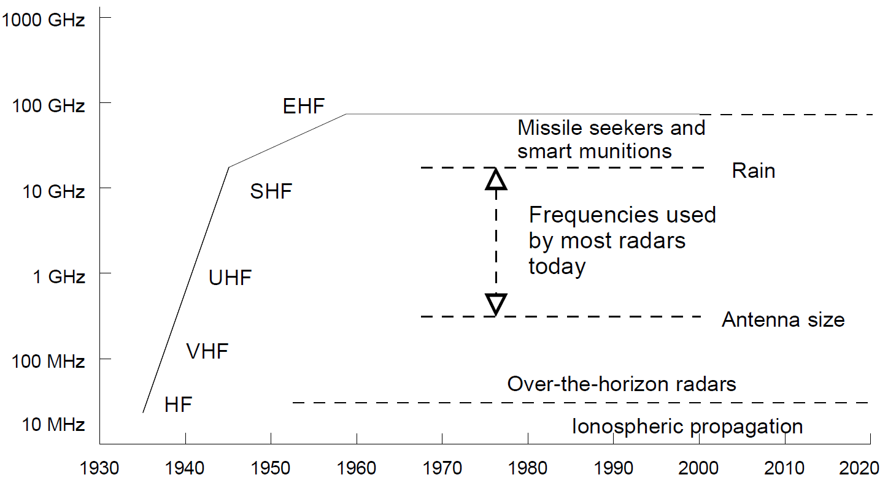
Radar Frequency Usage [US DoC, NTIA Special Pub. 00-40]

Slide 29
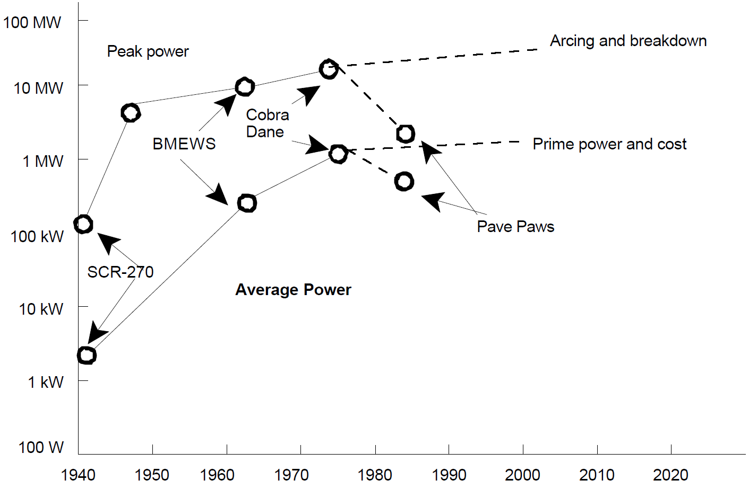
Radar Power [US DoC, NTIA Special Pub. 00-40]

Slide 30
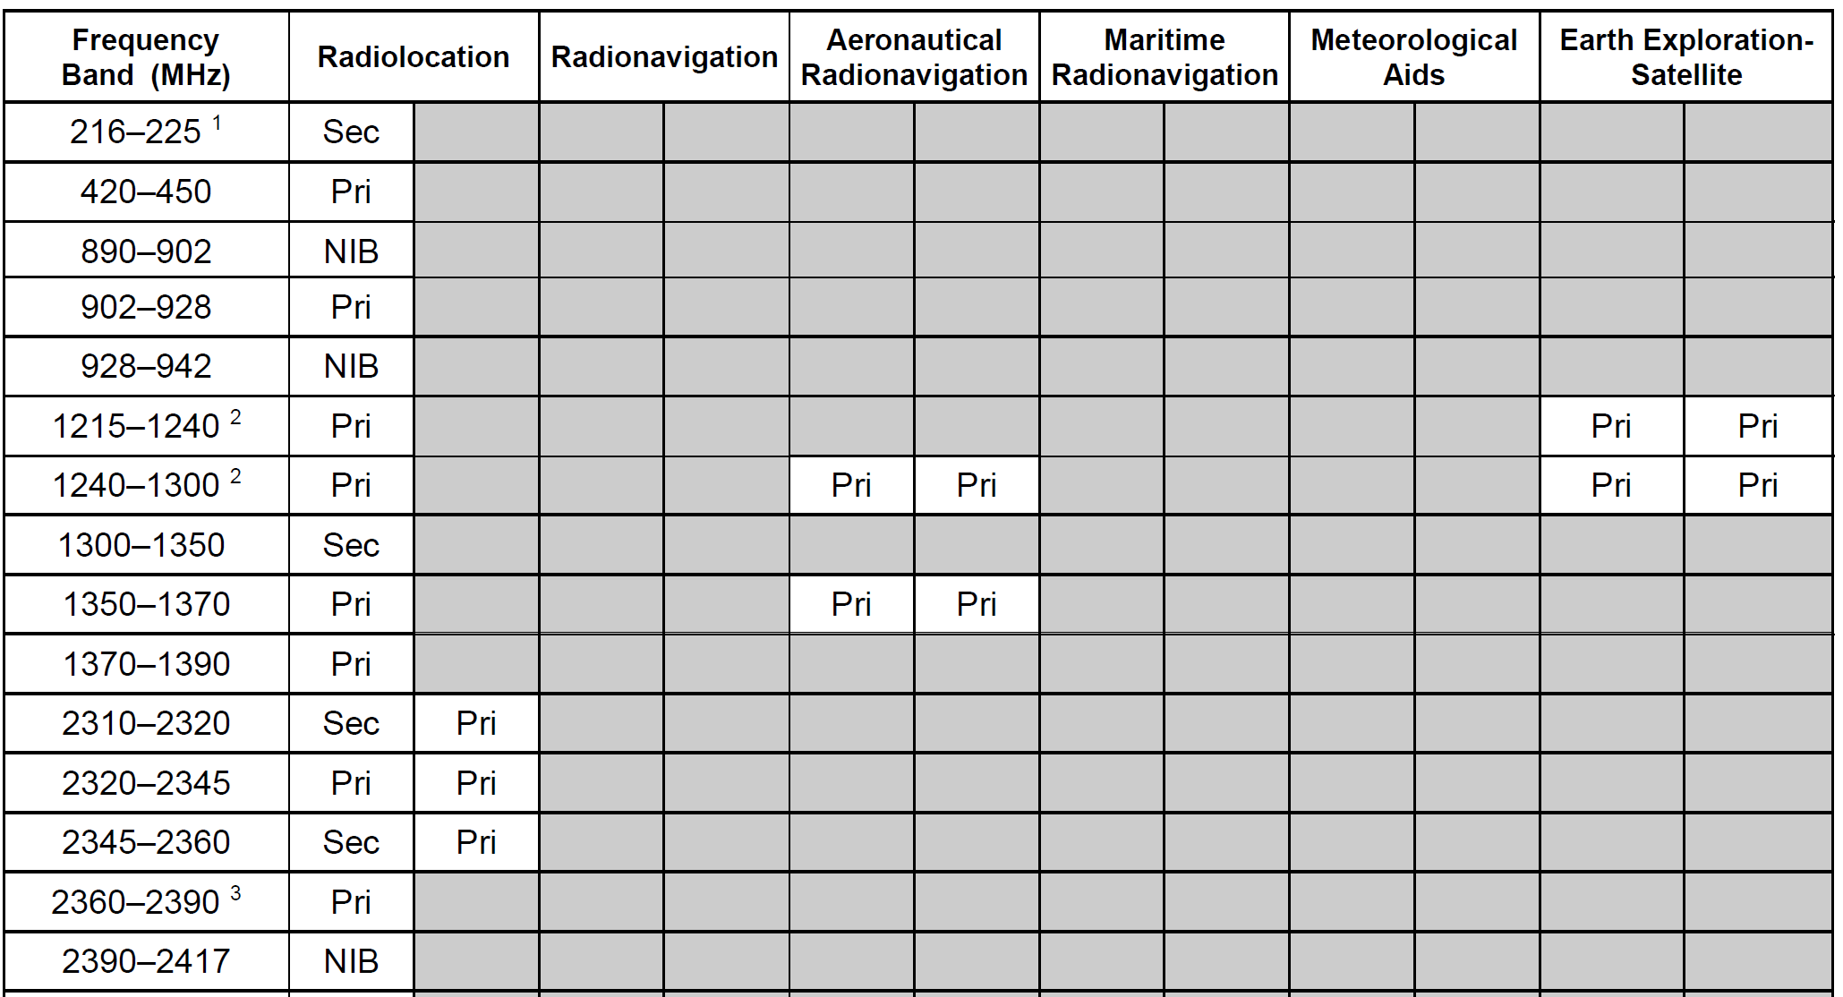
Radar Frequency Usage [US DoC, NTIA Specil Pub. 00-40]

Slide 31
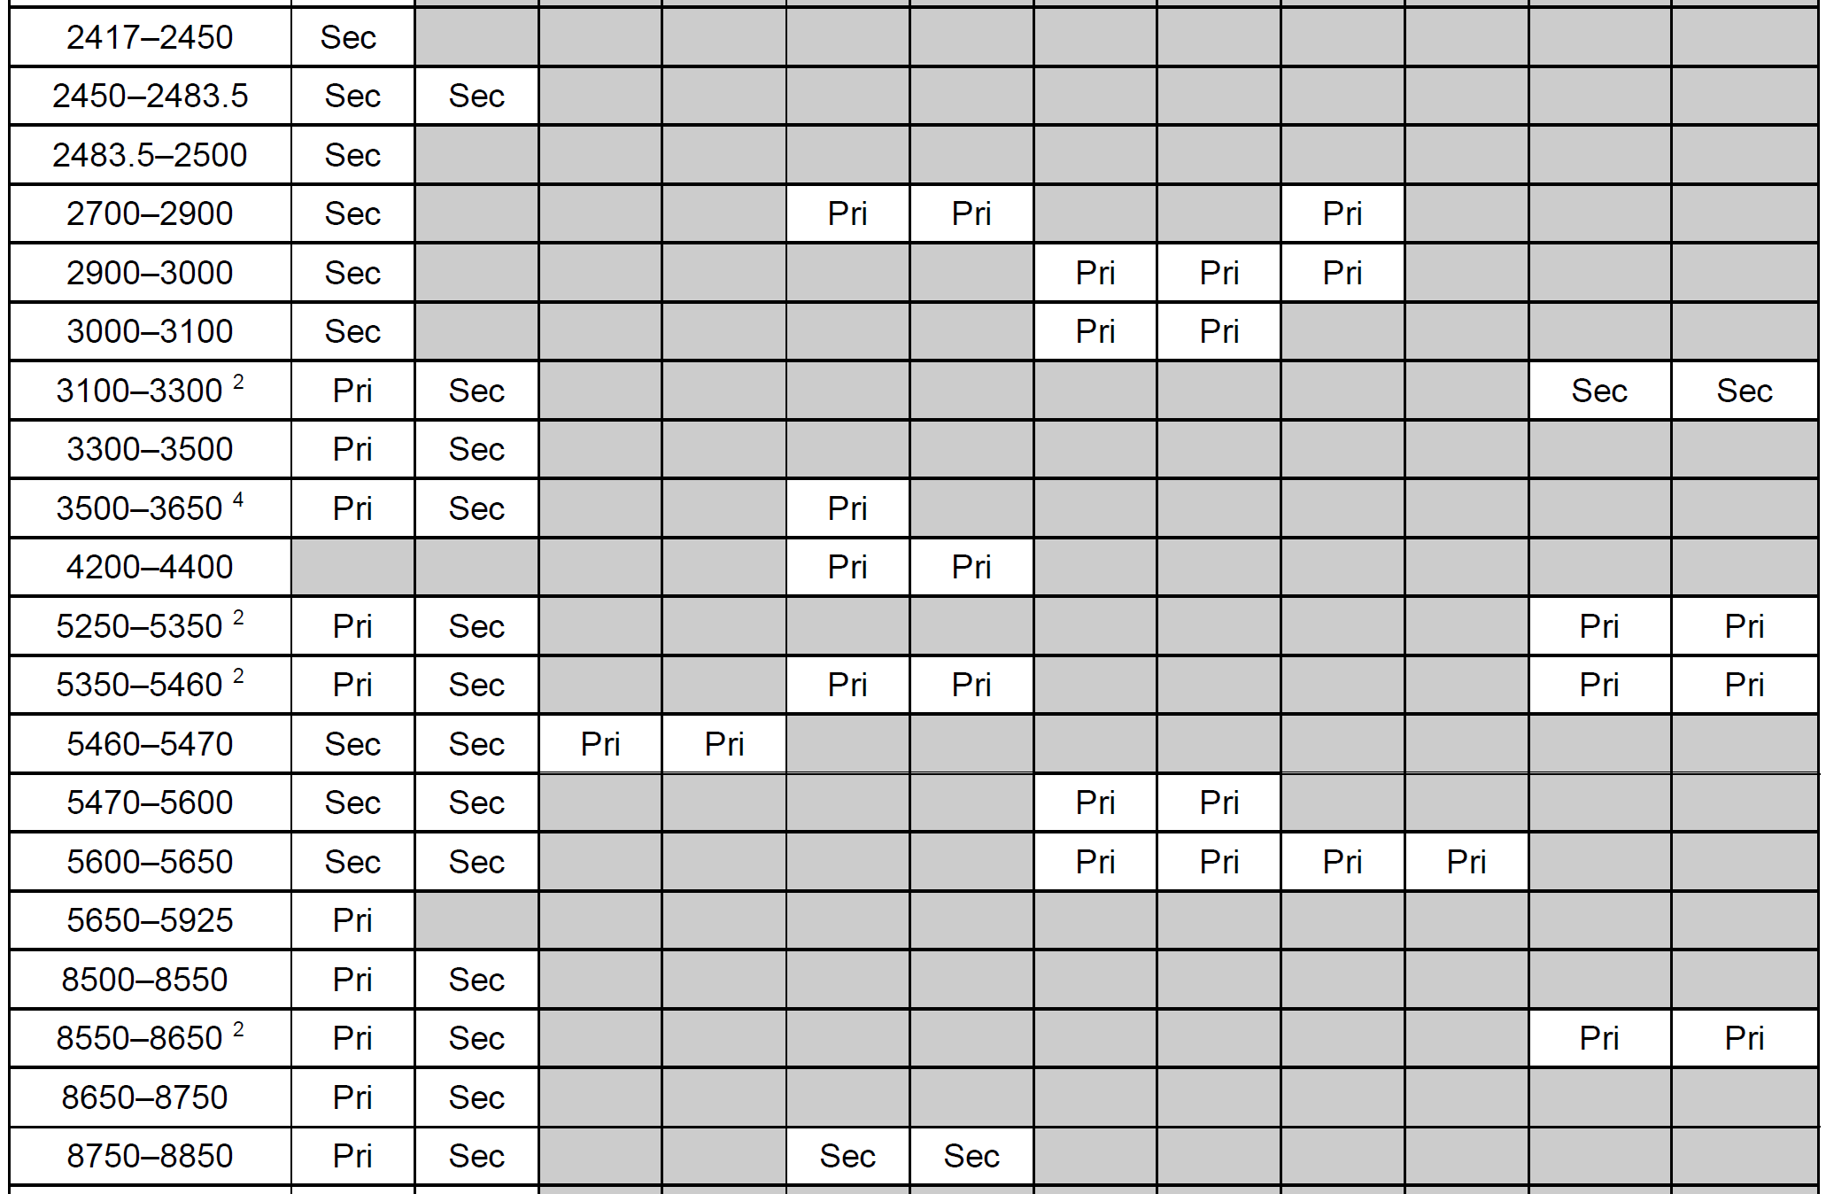
Radar Frequency Usage [US DoC, NTIA Specil Pub. 00-40]

Slide 32
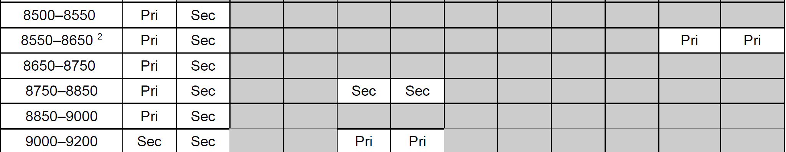
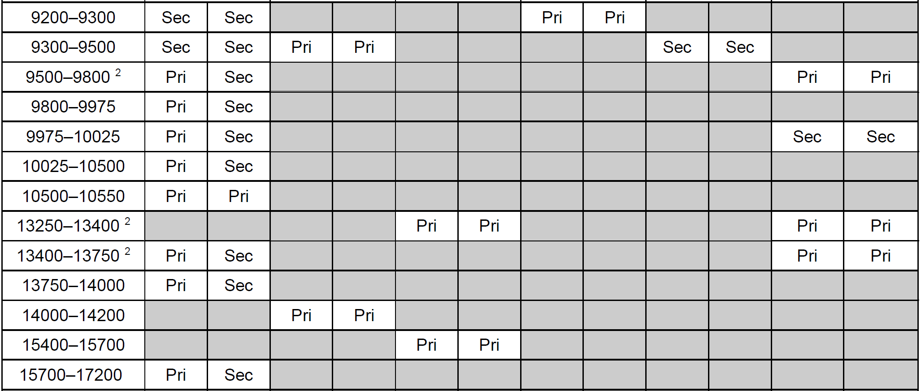
Radar Frequency Usage [US DoC, NTIA Specil Pub. 00-40]

Slide 33
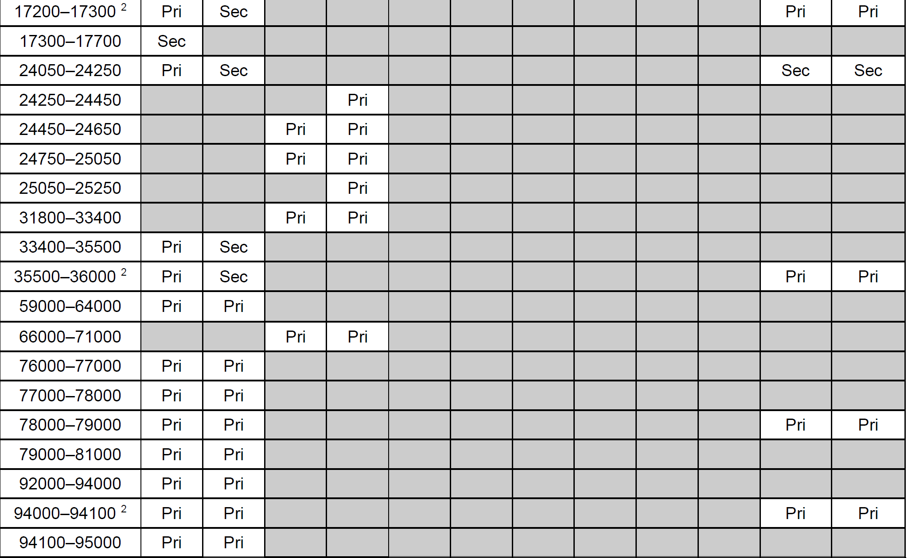
Radar Frequency Usage [US DoC, NTIA Specil Pub. 00-40]

Slide 34
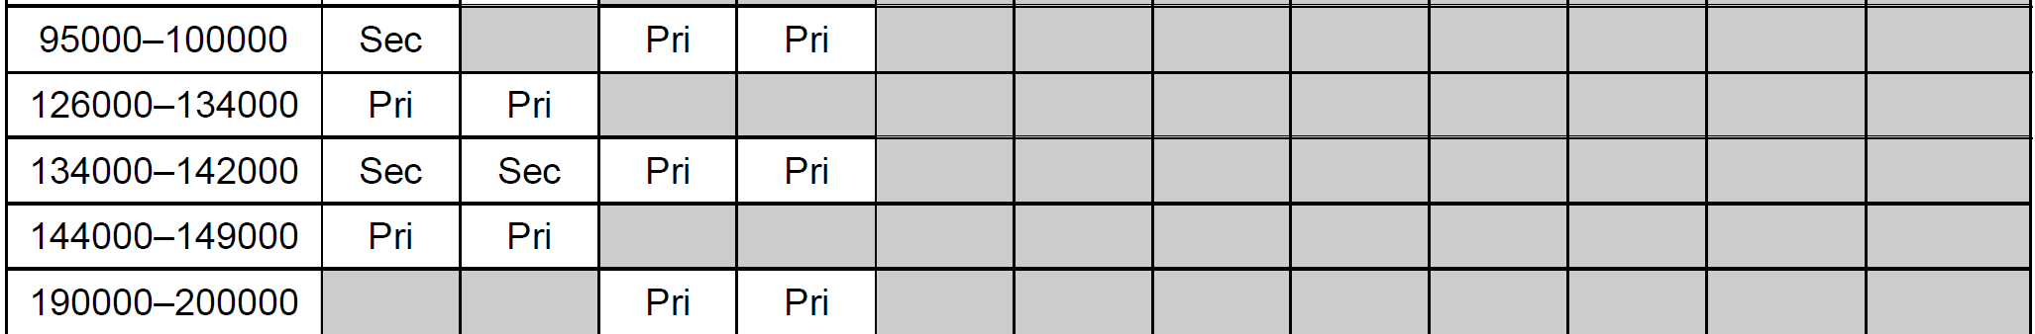
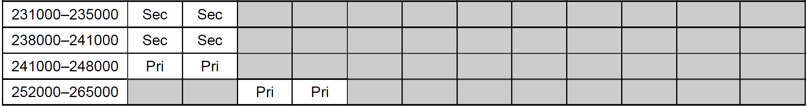
Radar Frequency Usage [US DoC, NTIA Specil Pub. 00-40]

Slide 35
Satellite Frequencies
UHF-band
- Shuttle Orbiter UHF System: backup for the S-band and Ku-band
systems. 243.0, 259.7, 296.8 MHz

Slide 36
Satellite Frequencies
L-band (1–2 GHz)
- GPS: 1.164-1.300 GHz, 1.544-1.610 GHz
- Satellite mobile phone
Iridium: 1.616-1.6265 MHz
Immarsat: 1.525-1.6465 MHz
Thuraya: 1.525-1.661 MHz
- WorldSpace satellite radio (DAB): 1.452-1.492 GHz
- MSS, BGAN, FleetBroadband, Global Handheld Satellite Phone:
up 1.6264-1.6605 GHz, down 1.525-1.559 GHz
- COSPAS-SARSAT: search and rescue satellite radiolocation system

Slide 37
Radar Frequency Usage [US DoC, NTIA Specil Pub. 00-40]
S-band (2–4 GHz)
- Deep space bands: uplink 2.11-2.12 GHz, downlink 2.29-2.30 GHz
- Near earth bands: uplink 2.025-2.110 GHz, downlink 2.20-2.29 GHz
- MSS (Mobile Satellite Service): 2.0-2.2 GHz
- Digital Audio Radio Service (DARS): 2.31-2.36 GHz
- Earth-to-space communication: 1.98-2.01 GHz
- Space-to-earth communication: 2.17-2.20 GHz
- Direct-to-Home satellite TV: 2.5-2.7 GHz
- Space Shuttle Orbiter S-band system (STDN, TDRS): 1.7-2.3GHz
- WIDESTAR II mobile satellite comm.: uplink 2.66-2.69 GHz,
downlink 2.505-2.535 GHz

Slide 38
Radar Frequency Usage [US DoC, NTIA Specil Pub. 00-40]
X-band (8-12 GHz)
- Space communication
Deep space bands: up 7.145-7.190 GHz, down 8.40-8.45 GHz
Near earth bands: up 7.190-7.235 GHz, down 8.45-8.50 GHz
- Military communication: COTM (communications-on-the-move)
up 7.9-8.4 GHz, down 7.25-7.75 GHz
NATO SATCOM Post-2000
- Civilian communication:
Skynet
Wideband Global SATCOM (WGS),
XTAR-EUR
Spainsat
Sicral, Syracuse,
DC-MS Series 2

Slide 39
Radar Frequency Usage [US DoC, NTIA Specil Pub. 00-40]
Ku-band (12–18 GHz)
- Space communication
Shuttle Orbiter Ku-band System: 15.25-17.25 GHz
- Civilian communication: direct broadcast
up 14 GHz, down 10.70-12.75 GHz

Slide 40
Radar Frequency Usage [US DoC, NTIA Specil Pub. 00-40]
Ka-band (26–40 GHz)
- Military: up 30.0-31.0 GHz, down 20.2-21.2 GHz
- Civilian: up 27.5-30.0 GHz, down 17.7-20.2 GHz
VSAT: up 29.6-30.0 GHz, down 19.8-20.2 GHz

