Slide 1
ICE-5108067 Electromagnetics
Lecture 02: Vector Calculus
1. Vector
2. Vector Addition and Subraction
3. Position Vector and Distance Vector
4. Scalar Product
5. Vector Product
6. Scalar and Vector Triple Products
7. Problems
8. Coding Examples

Slide 2
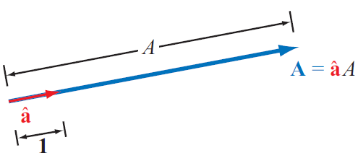
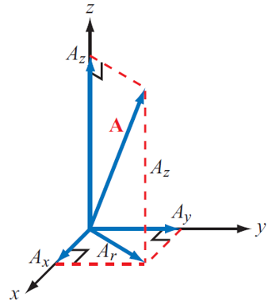
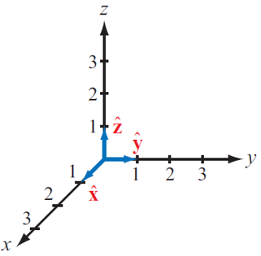
1. Vector
Vector:
- Magnitude and direction
- Vector notation: roman bold
- Magnitude notation: italic

Slide 3
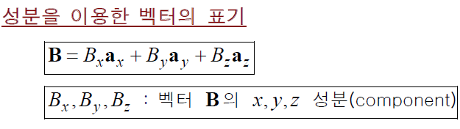
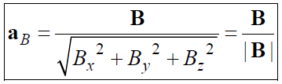
1. Vector
Vector component notation:
Unit vector (단위벡터):
- 벡터 B의 단위벡터 = B 방향의 단위벡터

Slide 4
1. Vector
Exercise:
Find the magnitude of a vector A = (1, 5, 3).
Find the unit vector of a vector A = (1, 5, 3).

Slide 5
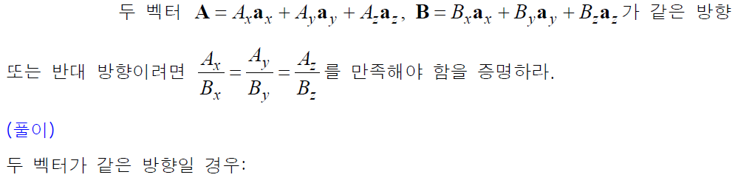
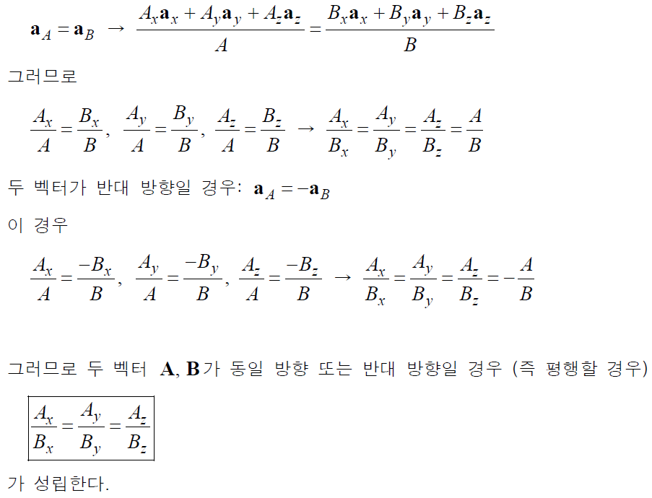
1. Vector
Exercise: 두 벡터가 평행할 조건

Slide 6
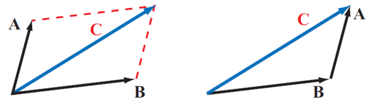
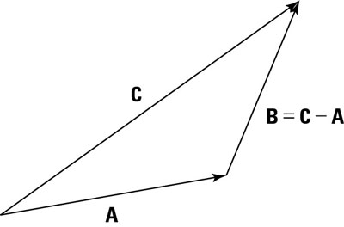
2. Vector Addition and Subtraction
Vector Addition:
Vector Subraction:

Slide 7
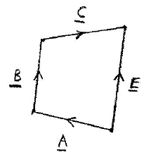
2. Vector Addition and Subtraction
Exercise:
Express the vector C using vectors A, B, and E.
Express the vector E using vectors A, B, and C.

Slide 8
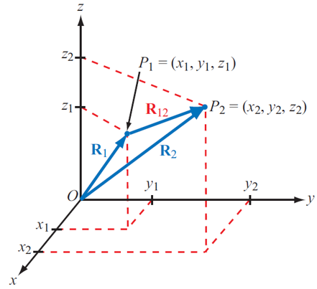
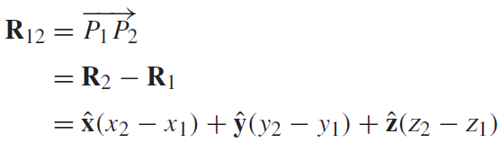
3. Position Vector and Distance Vector
Position vector:
Distance vector:

Slide 9
3. Position Vector and Distance Vector
Exercise:
Find the position vector R_{P} of a point P(1, 5, 3).
Find the distance vector R_{PQ} from a point P(1, 5, 3) to Q(2, 4, 1).

Slide 10
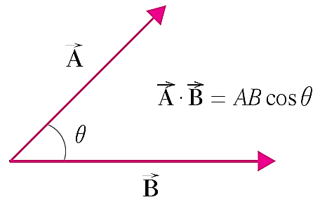
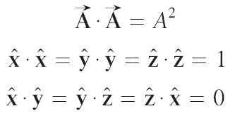

4. Scalar Prouct
Scalar or dot product:

Slide 11
4. Scalar Prouct
Scalar product의 활용:
- 직선과 점 사이의 거리
- 두 벡터의 사이각
- 두 벡터의 수직 여부
- 한 벡터를 다른 벡터에 수직인 성분과 수평인 성분으로 분해

Slide 12
4. Scalar Prouct
Exercise:
A triangle has vertices A(3, 2, 2), B(5, 4, 3), and C(−1, 6, 5)
Find the base length R_{AB} = |R_{AB}|.
Find the height with R_{AB} as the base.
Find the interior angle at the vertex A.

Slide 13
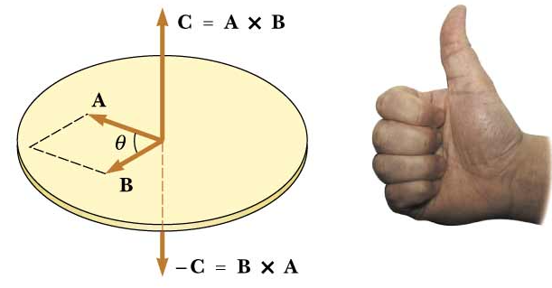
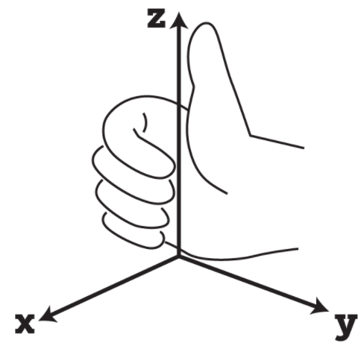
5. Vector Prouct
Vector or Cross Product:
- Right-hand rule

Slide 14
5. Vector Prouct
Lagrange's Identity:

Slide 15
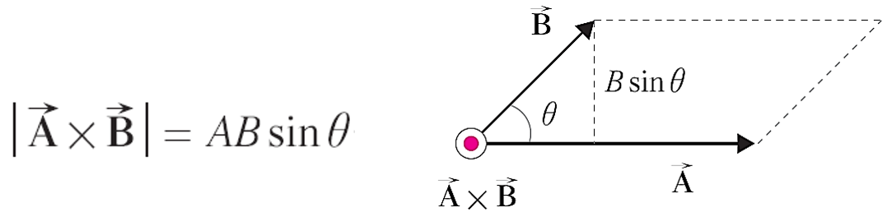
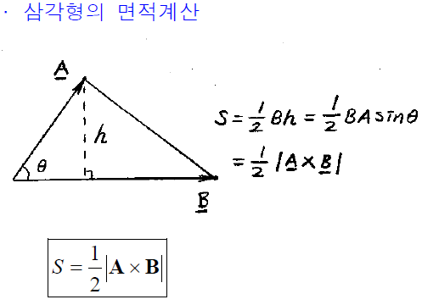
5. Vector Prouct
Area of a parallelepiped:
Area of a triangle:

Slide 16
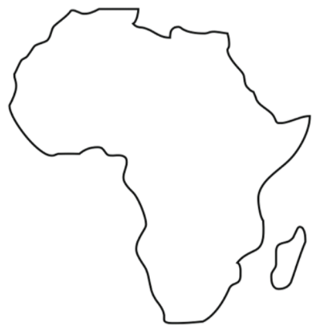
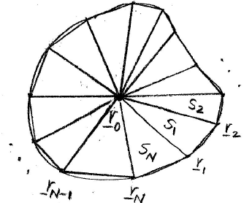
5. Vector Prouct
Exercise: 곡선으로 둘러 싸인 영역의 면적
- 곡선을 선분을 사용하여 근사화
- 선분 시점과 종점의 위치벡터: r₁, r₂, ..., r_{N}
- 좌표원점을 점 P에 설정: P = (r₁ + r₂ + ... + r_{N} ) / N
- 면적: S = S₁ + S₂ + ... + S_{N}

Slide 17
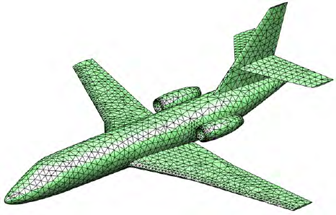
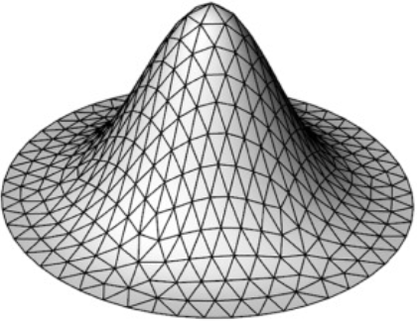
5. Vector Prouct
Exercise: 곡면의 면적
- 곡면 triangular meshing
- 각 삼각형의 면적을 구한 후 합한다.

Slide 18
5. Vector Prouct
Applications of Vector Product:
- A vector perpendicular to two vectors
- A vector perpendicular to a plane
- Torque calculation: T = R × F
- Check if two vectors are parallel to each other.
- Area of a triangle

Slide 19
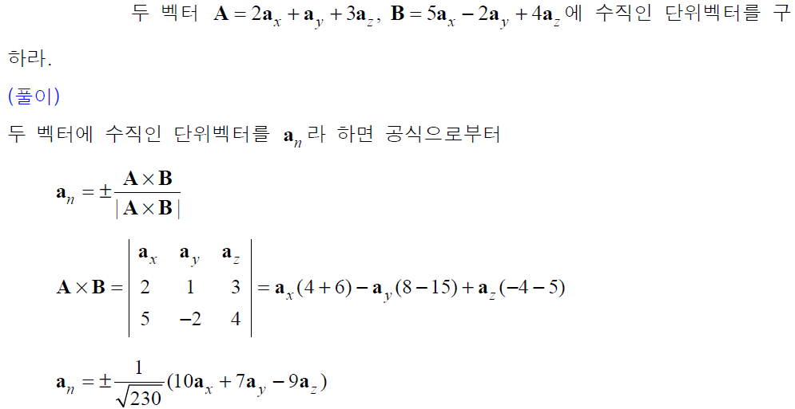
5. Vector Prouct
Exercise:

Slide 20
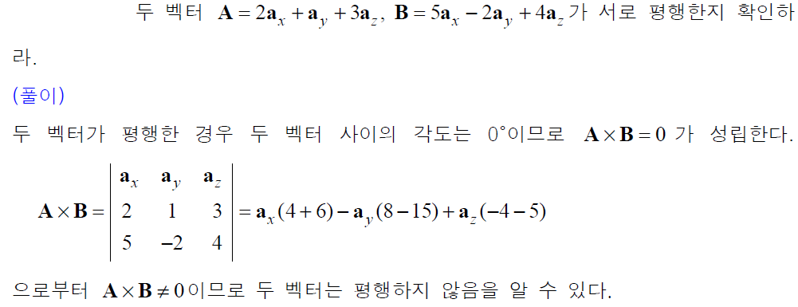
5. Vector Prouct
Exercise:

Slide 21
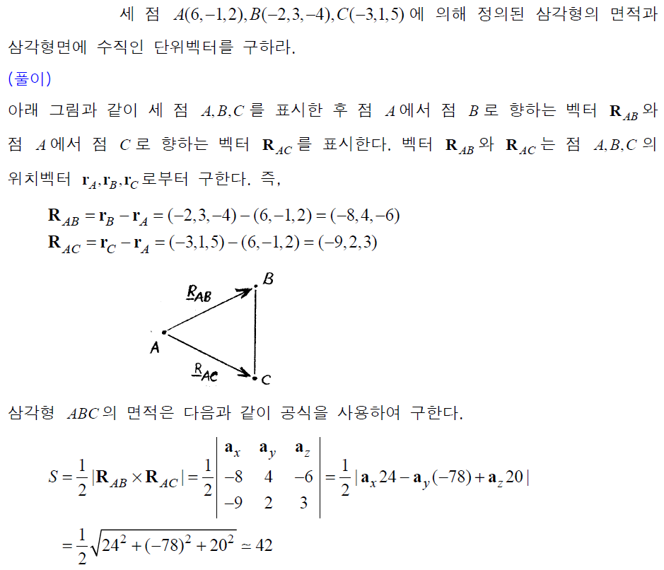
5. Vector Prouct
Exercise:

Slide 22
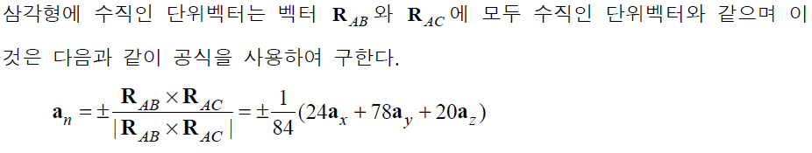
5. Vector Prouct
Exercise:

Slide 23
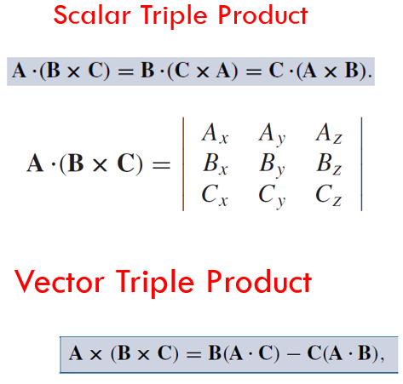
6. Scalar and Vector Tripole Proucts

Slide 24
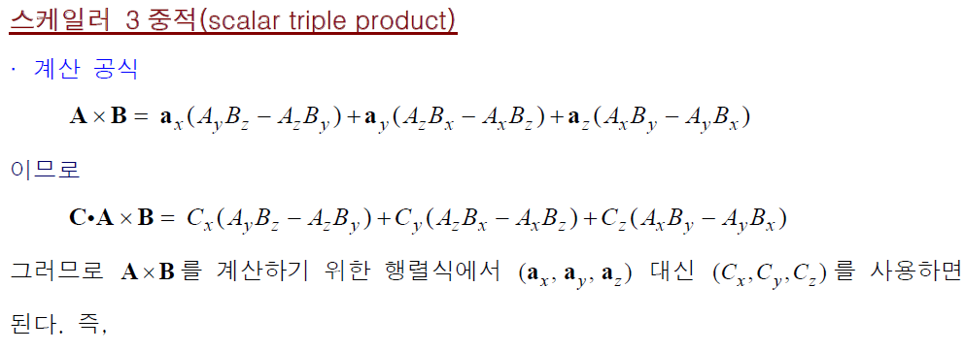
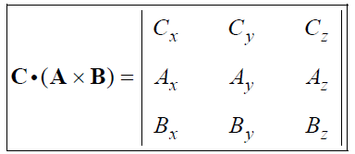

6. Scalar and Vector Tripole Proucts

Slide 25
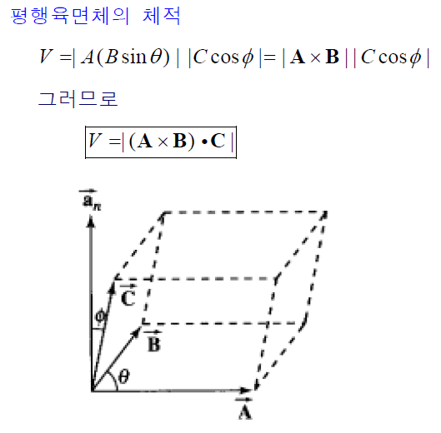
6. Scalar and Vector Tripole Proucts
Volume of a parallelepiped (평행육면체):

Slide 26
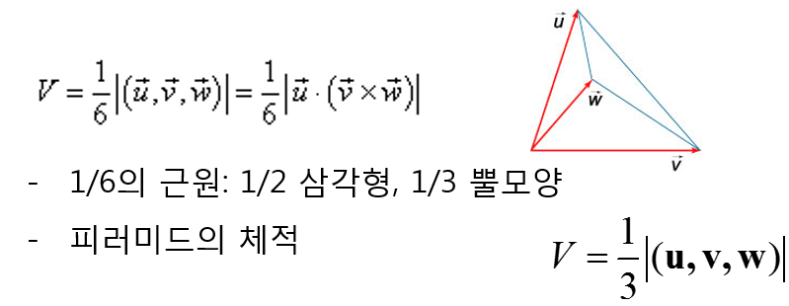
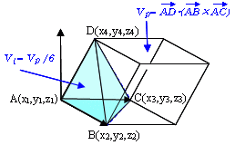
6. Scalar and Vector Tripole Proucts
Volume of a tetrahedron (사면체):

Slide 27
6. Scalar and Vector Tripole Proucts
Exercise:
Find the volume of a tetrahedron whose vertices are given by A(0, 4, 1),
B(4, 0, 0), C(3, 5, 2), D(2, 2, 5)
(Answer)
Take the point D(2, 2, 5) as a new coordinate origin. Then vectors A, B, and C define the tetrahedron.

Slide 28
7. Problems
1. A vector on the xy-plane is given A = (1, −1). Find a unit vector perpendicular
to A on the xy-plane.
2. A line A is defined by y = x+1. Find the minium distance from P(3, 2) to A.
3. Find the area of a triangle whose vertices are defined by A(1, −1), B(4, 0),
C(3, 3).
4. Find the area of a quadrangle whose vertices are defined by A(1, −1), B(4, 0),
C(3, 3), D(0, 1).
5. Find a unit vector perpendicular to A = (2, 1, 3) and B = (−1, 2, 4).
6. Find the volume of a tetrahedron whose vertices are given by A(1, 1, 2),
B(3, −2, 4), C(−2, 1, 3), D(5, 3, −5).

Slide 29
8. Coding Examples
1) Given a line A: y = ax + b, and, find a unit vector u parallel to A and a unit vector v normal to A.
(Answer)

Slide 30
8. Coding Examples
# EM-Lec1-Vecor_Calculus
# unit vector parallel to a line and unit vector normal to a line
import math
while True:
a=float(input('Line:y=ax+b; a='))
b=float(input('Line:y=ax+b; b='))
mag=math.sqrt(a**2+b**2)
ux=a/mag; uy=b/mag
vx=-b/mag; vy=a/mag
print('ux,uy=',ux,uy)
print('vx,vy=',vx,vy)
'''
Line:y=ax+b; a=
1
Line:y=ax+b; b=
2
ux,uy= 0.4472135954999579 0.8944271909999159
vx,vy= -0.8944271909999159 0.4472135954999579
Line:y=ax+b; a=
'''

Slide 31
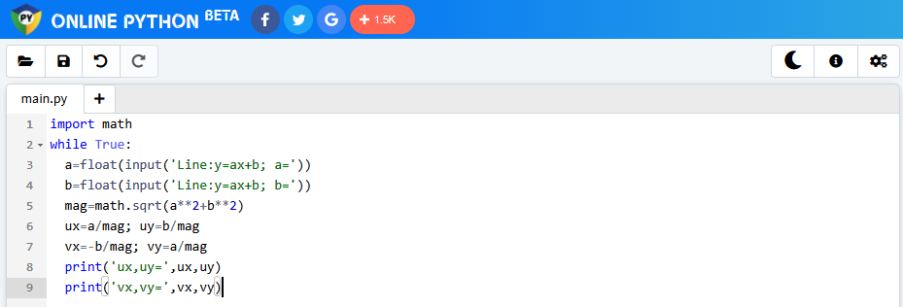
https://www.online-python.com/ 에 접속하여 소스코드를 위창에 copy
[Run]아이콘 클릭
아래창에 데이터 입력 prompt가 표시되면 키보드로 데이터 입력
출력은 아래창에 표시됨.
- 소스코드 입력창(위창)
(proof given later)
- 상단 아이콘을 사용하여 필요한 작업
Open file From Disk
Save File to Disk
Undo
Redo
Change Theme
About Site
Settings

Slide 32
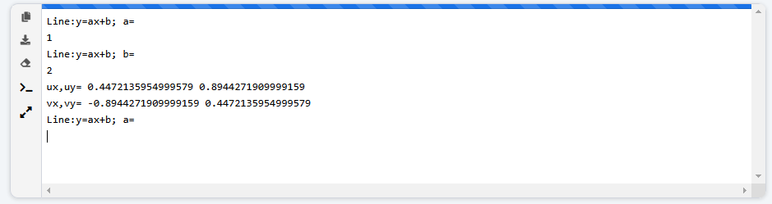
- 입출력창 (아래 창)
(proof given later)
- 좌측 아이콘을 사용하여 필요한 작업
Copy to clipboard: 출력창 내용을 클립보드에 copy (다음에 Ctrl+v로 문서에 삽입)
Download: 출력창 내용을 txt 파일로 컴퓨터로 다운로드
Clear: 출력창 내용 지움
Smart terminal: >>>가 표시되고 interpreter 모드. Python를 1줄씩 실행. help(print)
와 같이 help 표시
Expand/Collapse: Expand = 출력창만 전체화면에 표시, Collapse: 위창, 아래창 동시표시

Slide 33
8. Coding Examples
2) Given three points with position vectors r₁ = (x1, y₁, z₁), r₂ = (x₂, y₂, z₂) and
r₃ = (x3, y₃, z₃), find 1) a vector c = (r₂ − r₁) × (r₃ − r₁), 2) the area of a triangle whose vertices are r₁, r₂, and r₃, and 3) unit vectors n₁ and n₂ which are normal to the triangle.
(Solution)

Slide 34
8. Coding Examples
# EM-Lec1-Vecor_Calculus
# Three points r1=(x1,y1,z1), r2=(x2,y2,z2) and r3=(x3,y3,z3)
# are given. Find 1) a vector c=(r2-r1)x(r3-r1), 2) the area of
# a triangle whose vertices are r1, r2, and r3, and 3) unit
# vectors n1 and n2 perpendicular to the triangle.
import math
while True:
x1,y1,z1=map(float, input('x1,y1,z1=').split())
x2,y2,z2=map(float, input('x2,y2,z2=').split())
x3,y3,z3=map(float, input('x3,y3,z3=').split())
ax=x2-x1; ay=y2-y1; az=z2-z1
bx=x3-x1; by=y3-y1; bz=z3-z1
cx=ay*bz-az*by; cy=az*bx-ax*bz; cz=ax*by-ay*bx
print('c=(r2-r1)x(r3-r1)=(',cx,',',cy,',',cz,')')
cmag=math.sqrt(cx**2+cy**2+cz**2)
area=cmag/2
n1x=cx/cmag; n1y=cy/cmag; n1z=cz/cmag
n2x=-n1x; n2y=-n1y; n2z=-n1z
print('Area of the triangle=',area)
print('n1x,n1y,n1z=(',n1x,',',n1y,',',n1z,')')
print('n2x,n2y,n2z=(',n2x,',',n2y,',',n2z,')')
""
x1,y1,z1=
0 4 3
x2,y2,z2=
2 6 1
x3,y3,z2=
3 1 9
c=(r2-r1)x(r3-r1)=( 6.0 , -18.0 , -12.0 )
Area of the triangle= 11.224972160321824
n1=( 0.2672612419124244 , -0.8017837257372732 , -0.5345224838248488 )
n2=( -0.2672612419124244 , 0.8017837257372732 , 0.5345224838248488 )
x1,y1,z1=
""

Slide 35
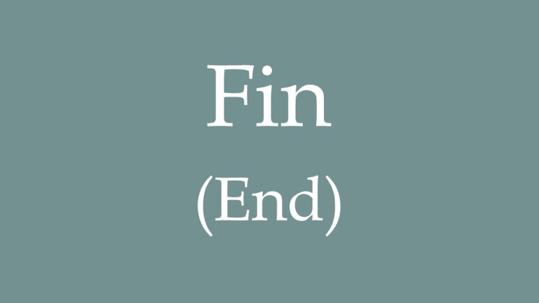
ICE-5108067 Electromagnetics
Lecture 01: Vector Calculus

