Slide 1
Lecture 4 Electrostatics (1)
1. Electric Charge
2. Electrostatic Force
3. Coulomb's Law
4. Electric Field
5. Coding Examples

Slide 2
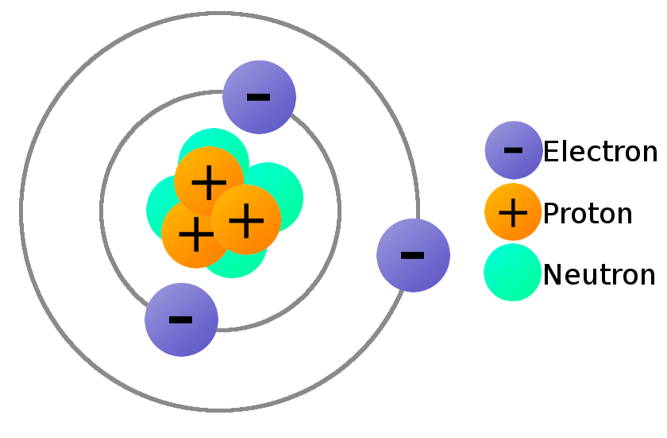
1. Electric Charge
Sources of Electric Charge
- All matter is made up of atoms.
- Atoms contain
- Protons (+)
- Neutrons (0)
- Electrons (−)
- Protons and neurons are tightly bound to atoms.
- Electrons can move away from their atoms.
Ref: learn.sparkfun.com

Slide 3
Charging / Charged / Ionization
- An object acquires electrons. → Negatively charged
- An object loses electrons. → Postively charged
Charging Mechanisms
- By contacts: contact electrification, triboelectric effect
- By pressure: piezoelectric effect
- By heat: pyroelectric effect
- By charge or electric field: influence charging, corona charging
- Electrochemical charging: battery
- Diffusion charging: aerosol particles are brought into contact with gas phase
ions

Slide 4
Charge of An Electron
- Charge is quantized.
- Elementary charge:
e = 1.602 176 634×10⁻¹⁹ C
- Unit of charge: C (Coulomb)
- Charge of an electron: Q_{e} = −e
- Charge of a proton: Q_{p} = +e
Charge Conservation
- The total electric charge in an isolated system never changes.
- The net quantity of electric charge, the amount of positive charge minus the
amount of negative charge in the universe, is always conserved.

Slide 5
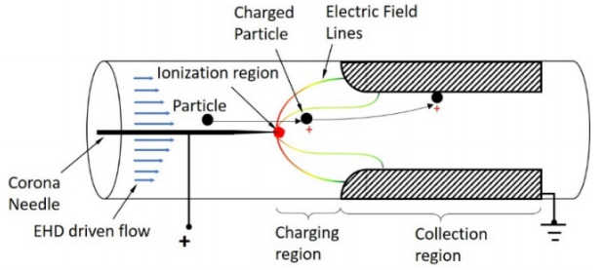
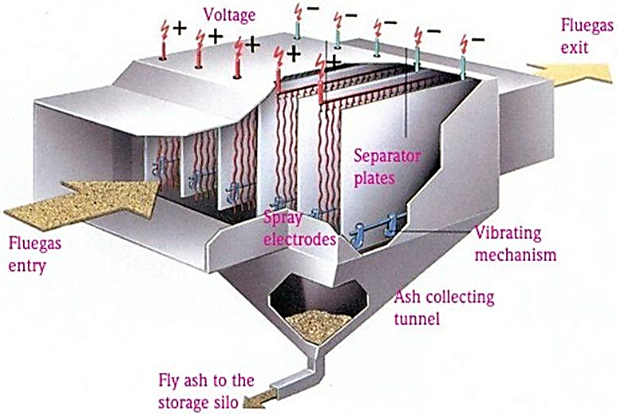
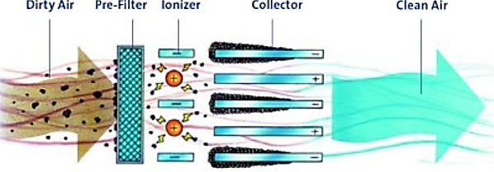
Corona (= air ionization with bluish voilet light) Charging
Electrostatic Precipitator, Air Purifier

Slide 6
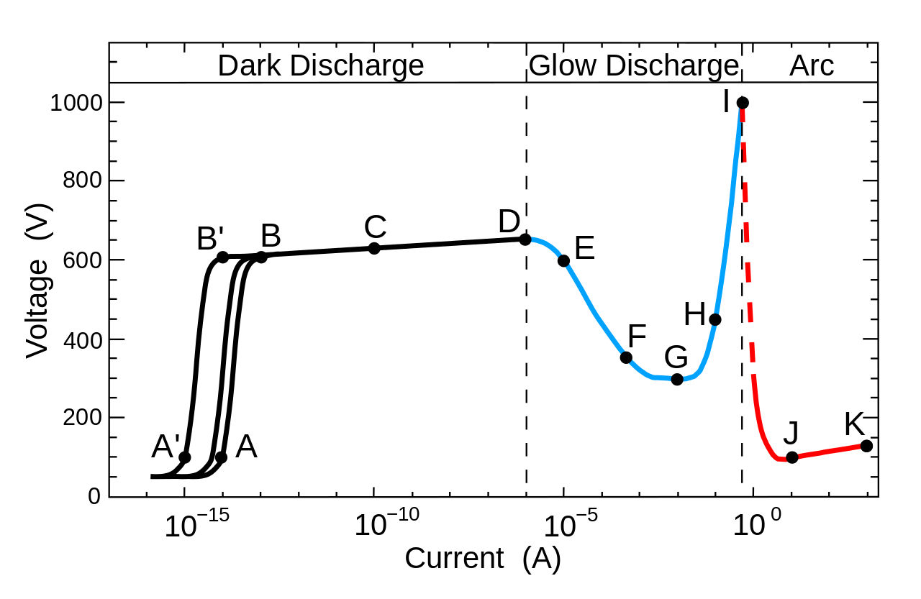
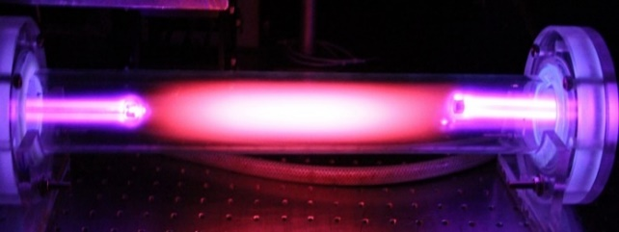
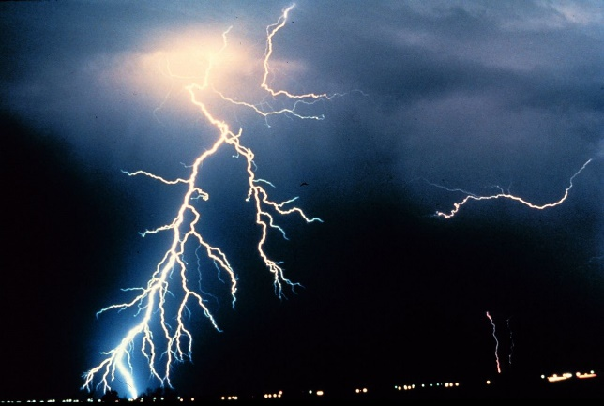
Discharge
- An object loses all of its charges either by regaining all of its lost electrons or by
losing all of its acquired electrons.
- Electrical discharge in gases
A: cosmic radiation random pulses
C: Townsend discharge
E: corona discharge = air breakdown by high electric field
G: glow discharge = passage of electric current through a gas
J: arc discharge = with continuous current

Slide 7
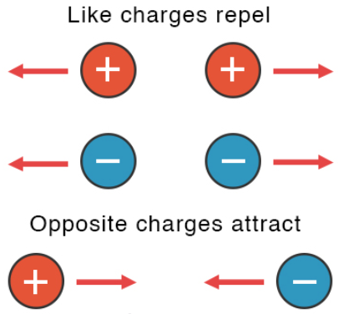
2. Electrostatic Force
Electrostactic Force in Materials
- In atoms, protons & electrons exert force on each other.
- Forces between molecules
Electrosatic Force in Industrial Applications
- Printers: laser printer, ink jet printers
- Air purifier, electrostatic precipitator
- Electrostatic spray gun (coating)
- Forensics: electrostatic dust print lifting
- Particle separation and sizing
- Electrostatic atomization: liquids to uniformly dispersed aerosol
- Plastics identification for recycling
- Powder coating

Slide 8
3. Coulomb's Law
Coulomb's Law
Example:
- Coulomb force in the hyrdogen atom
Q_{e} = − 1.6×10⁻¹⁹ C , Q_{p} = 1.6×10⁻¹⁹ C, R = 5.3×10⁻¹¹ m

Slide 9
4. Electric Field
Electric Field and Force
Electric Field

Slide 10
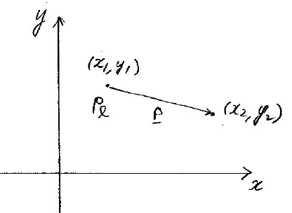
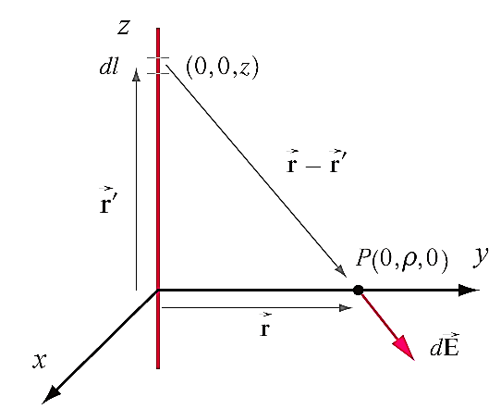
Example: Electric field of an infinite line charge
Example: Electric field of a finite line charge

Slide 11
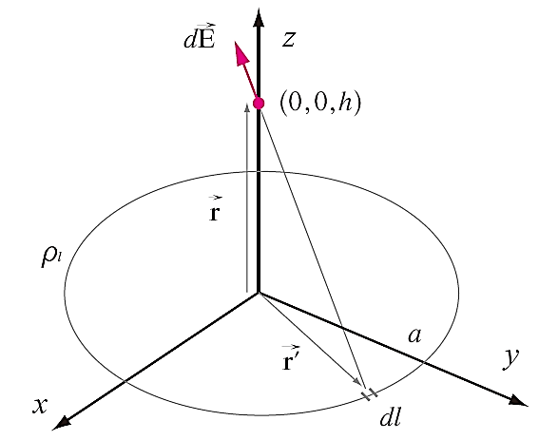
Example: Electric field of a loop charge

Slide 12
Example: Electric field of a finite rectangular surface charge
Field point r = (0, 0, 0)
Source point r' = (x, y, z), x₁ ≤ x ≤ x₂, y₁ ≤ y ≤ y₂
R = r − r' = (−x, −y, −z)

Slide 13
Example: Surface ring charge
Field point r = (0, 0, h)
Source point r' = (ρ, φ, 0), ρ₁ ≤ ρ ≤ ρ₂, φ₁ ≤ φ ≤ φ₂

Slide 14
5. Coding Examples
Example 1:
Infinite line charge: charge density σ (C/m), location (x_{s}, y_{s}) m
Field point: P(x, y) m
Find the electric field E at P.
(Solution)
- Formulas
- Code
# EM-Lec4-Example 1: Single line charge
# Given a line charge at (xs,ys) m with charge density s (C/m)and
# the field point P(x,y) m, find the electric field E at P
from math import *
e0=8.853e-12;pi=3.141593
while True:
s=float(input('Charge density s (C/m) ='))
xs,ys=map(float,input('Line charge position xs,ys (m) =').split())
x,y=map(float,input('Field point x,y (m) =').split())

Slide 15
6. Coding Examples
rx=x-xs;ry=y-ys
r=sqrt(rx**2+ry**2)
ex=s/(2*pi*e0)*rx/r**2
ey=s/(2*pi*e0)*ry/r**2
print(' E (V/m) = (',ex,',',ey,')')
'''
Charge density s (C/m) =
-2e-9
Line charge position xs,ys (m) =
3 4
Field point x,y (m) =
1 2
E (V/m) = ( 8.988756666810751 , 8.988756666810751 )
Charge density s (C/m) =
'''

Slide 16
Example 2:
1) 문제
n infinite line charge:
Charge 1: density σ₁ (C/m), location (x₁, y₁) m
...
Charge n: density σ_{n} (C/m), location (x_{n}, y_{n}) m
Field point: P(x, y) m
Find the electric field E at P.
2) 수식
3) 코드
# EM-04-Python-Ex2: Multiple line charges
# Given line charges at (xi,yi) m with charge density si (C/m), i=1,2,...
# (선전류 개수는 코드실행시 결정)
# and the field point P(x,y) m, find the electric field E at P

Slide 17
from math import *
e0=8.853e-12;pi=3.141593
xs=[0]*100; ys=[0]*100; s=[0]*100
# xs, ys, s는 모두 갯수가 100인 list이며 0의 값으로 초기화
# xs[0] 부터 xs[99]까지 총 100개 list 변수 사용 가능
# 변수 뒤에 [ ]는 list라 하면 변경가능하며 데이터형도 모두 수용가능한 배열. 지금의 경우 ]
# 1차원 배열. 2차원 배열은 s[i][j]로 표현. List를 사용하려면 사용하기 전에 초기화 해야 함.
while True: # while loop 1
i=0; ex=0; ey=0
x,y=map(float,input('Field point x,y (m) =').split())
while True: # while loop 2
print('Line charge no.=',i)
s[i]=float(input('Charge density s (C/m)(0 to finish defining line charges) ='))
if s[i]==0:
break # get out of while loop 2
xs[i],ys[i]=map(float,input('Line charge position xs,ys (m) =').split())
rx=x-xs[i];ry=y-ys[i]
r=sqrt(rx**2+ry**2)
ex=ex+s[i]/(2*pi*e0)*rx/r**2
ey=ey+s[i]/(2*pi*e0)*ry/r**2
i=i+1
print('E (V/m) = (',ex,',',ey,')')

Slide 18
4) 코드 수행결과
Field point x,y (m) =
1 2
Line charge no.= 0
Charge density s (C/m)(0 to finish defining line charges) =
3e-9
Line charge position xs,ys (m) =
3 4
Line charge no.= 1
Charge density s (C/m)(0 to finish defining line charges) =
-1e-10
Line charge position xs,ys (m) =
4 6
Line charge no.= 2
Charge density s (C/m)(0 to finish defining line charges) =
0
E (V/m) = ( -13.267404840212667 , -13.19549478687818 )
Field point x,y (m) =** Process Stopped **
Press Enter to exit terminal

Slide 19
Example 3:
A point charges: charge q C, location (x_{s}, y_{s}, z_{s}) m
Field point: P(x, y, z)
Find the electric field E at P.
(Solution)
- Formulas
- Codes

Slide 20
Example 4:
n point charges:
Charge 1: charge q₁ C, location (x₁, y₁, z₁) m
...
Charge n: density q_{n} C, location (x_{n}, y_{n}, z_{n}) m
Field point: P(x, y, z)
Find the electric field E at P.
(Solution)
- Formulas
- Codes

Slide 21
