Slide 1
Lecture 6 Electrostatics (3)
1. Free Electrons
2. Conductors and Electrostatic Field
3. Current and Resistance
4. Charge Continuity
5. Coding Example

Slide 2
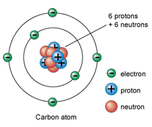
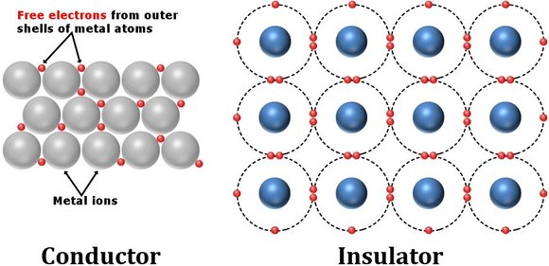
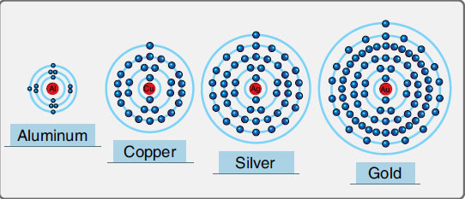
1. Free Electrons
Free electrons and conductors
- Free electrons: fee to move by E field
- Conductors:
Mostly metals: copper, aluminum, gold, silver
Has a large free electron density: n_{e} = 10²⁹ /m³

Slide 3
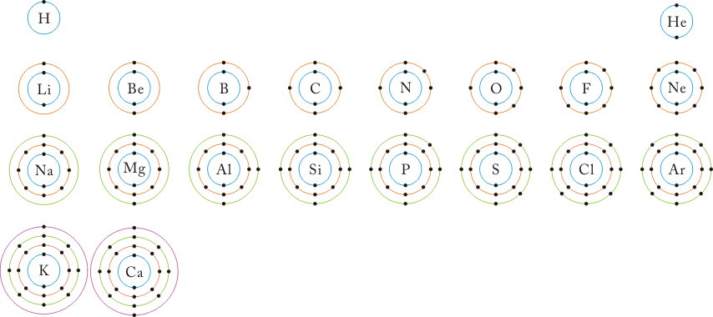
1. Free Electrons
http://iokm.net/?document_srl=2512

Slide 4
1. Free Electrons
Example:
Cu density: 9×10³ kg/m³
Atomic mass: 63.5
Number of free electrons per atom: 1
Find the number n_{e} of free electrons per cubic meter.

Slide 5
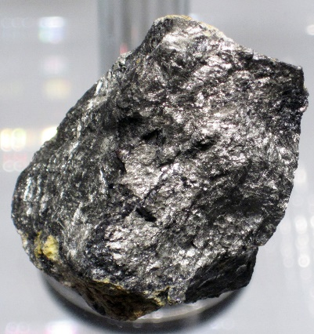
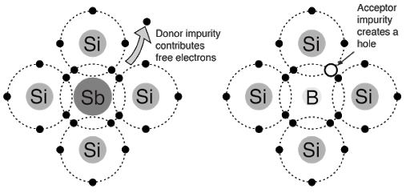
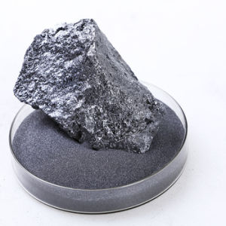
Semiconductors
- Silicon, gemanium
- Charge carrying mechanisms: electrons, holes, majority carrier, minority carrier
- n-type and p-type semiconductors
- Electron density smaller than conductors: n_{e} = 10¹⁰ (Si), 10¹³ (Ge) /m³
- Charge carrier density controlled by inserted impurities: 10¹⁶ - 10²⁵ /m³
⁵¹Sb_{121.760} : antimony (안티모니) (합금, 반도체; 유독성)
⁵B_{10.811} : boron (붕소) (내화유리, 살충제, 중성자흡수
제어봉, 고강성섬유, 고강도 화합물 기계 재료, 반도체)

Slide 6
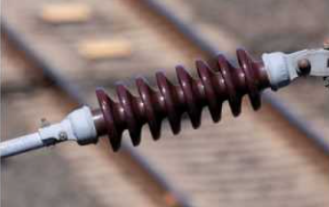
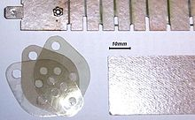
Insulators
- Electron densiy much smaller than conductors: n_{e} = 10⁶ /m³
- Ceramic (porcelain), plastic
- Dielectric materials
- Dielectric breakdown: 20 (vacuum), 30 (air), 200 (PE), 100 (porcelain),
600 (Teflon), 1000 (glass), 2000 (mica) kV/cm
- Porcelain high-voltage insulator string
- Mica circuit insulator

Slide 7
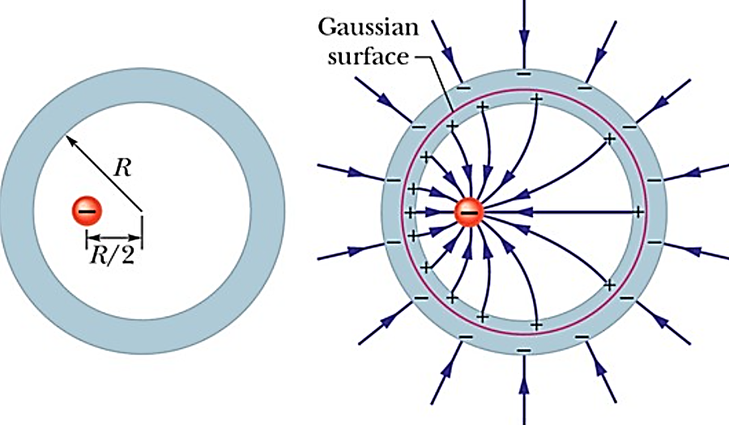
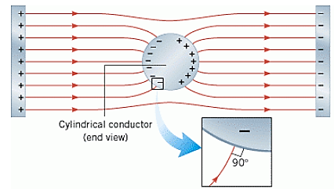
2. Conductors and Electrostatic Field
Charge induction
- Induction by a field internal to a conductor
- Induction by a field external to a conductor

Slide 8
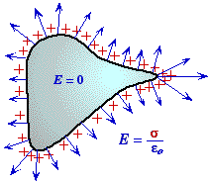
Conductor and electric field
- PEC (perfect electric conductor)
- Infinite conductivity: σ = ∞ (no work required to move a chage)
- Zero electric field inside: E = 0 (inside)
- Charge only on the surface if any: ρ_{s} = surface charge density (C/m²)
- Zero charge density inside the conductor: ρ_{v} = 0
- Same potential inside the conductor and on the suface: V = const
- Electric field normal to the surface: E_{tan} = 0
- Charge density related to flux density: ρ_{s} = D_{n} = E_{n} / ε

Slide 9
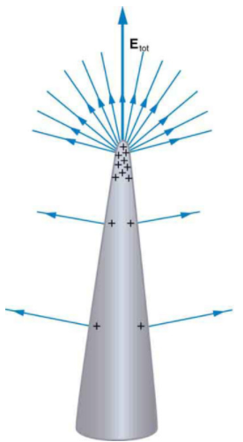
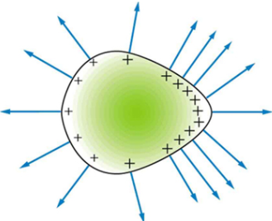
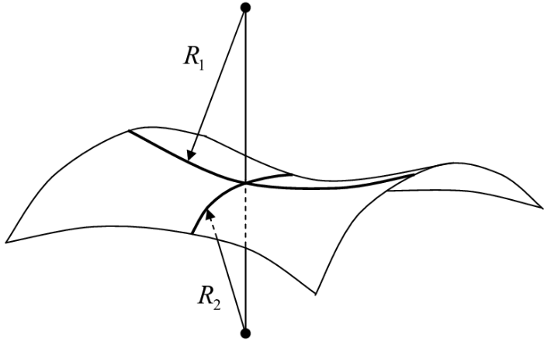
Electric field on a conductor

Slide 10
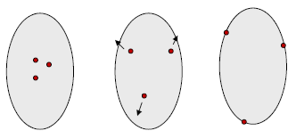
Charge distribution on the conductor surface
1. Inject some charges of the same sign inside a conductor
2. Charges make E field
3. E field repels charges against each other
4. Charges move to the conductor surface until the only force on a charge is normal
to surface. → Total E is normal to surface. E_{tan} = 0 → E_{tan} = ∂V/∂t = 0 → V = const on the conductor surface

Slide 11
Summary of equations for conductors in electric field

Slide 12
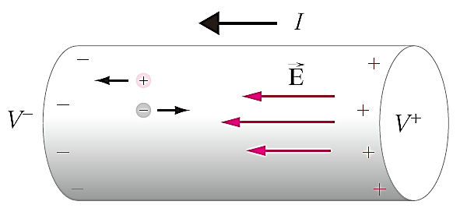
3. Current and Resistance
Current
- Potential difference in a material → E field
→ F = qE → charge movement → current (electric current) flow
Definition of current

Slide 13
Current, order of magnitude
10 uA : ventricular fibrillator (제세동기)
0.7 mA: hearid aid (보청기, 1.4 V 1 mW)
1 mA : threshold of human sensation
16 mA : maximum safe current of average man (grasp and letgo)
20 mA : LED current, human respiratory paralysis
100 mA : heart stops beating
200 mA : 220V 44W tungsten incandescent light bulb
10A : 220V electric kettle
100 A : motor vehicle starter
300 A : 30 V arc welder
400 A : KTX-산천, 10 MW, 25 kV 400A
2 kA : 115 kV electrical substation
30 kA : lightning strike
200 kA : electric arc furnace
10¹⁸ A: black-hole magnetic-field driven current

Slide 14
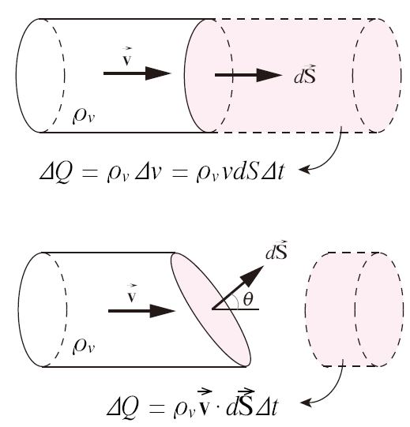
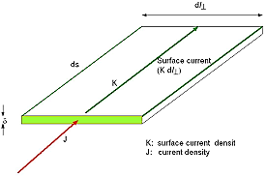
Volume current density
Surface current density

Slide 15
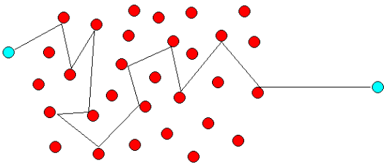
Electron drift velocity
Fermi speed: random electron motion. v_{F} = 1.57 x 10⁶ m/s (copper)
Meam free path : average path length of an electron before collision.
L_{d} = 4 x 10⁻⁸ m (Cu)
Drift velocity: electron velocity under applied E field

Slide 16
Conductivity and resistivity

Slide 17
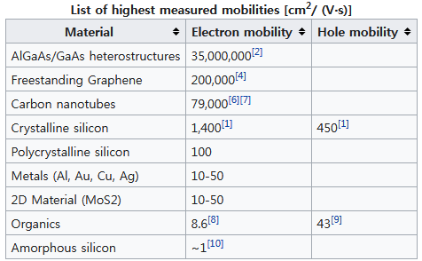
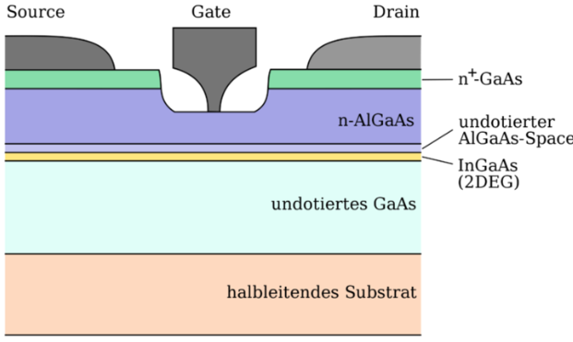
Electron mobility table
- HEMT (high electron mobility transistor): used in low-noise, very high frequency
amplifier

Slide 18
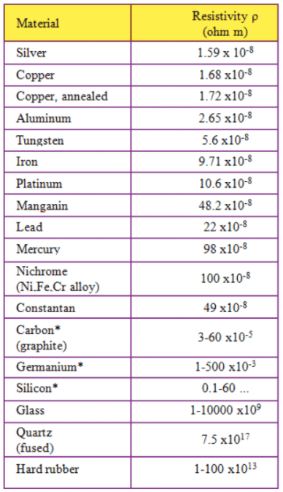
Electrial resistivity of materials
- Resistance wire: nichrome, 1 μohm-meter
80/20 = 80% Ni + 20% Cr
Menting point 1350°C
Max. op. temp. 1150°C
220V 2kW heater: wire temp. 300-500°C Resistivity about 60 times that of Cu
- Mica: 1× 10¹³ ohm-meter
- Quartz: 10¹⁰ to 10¹⁷ ohm-meter
- Diamond: 10¹¹ to 10¹⁸ ohm-meter
- Water:
Pure: 2×10⁹
Distilled: 5×10⁶
River water: 20,000
Sea water: 2,000

Slide 19
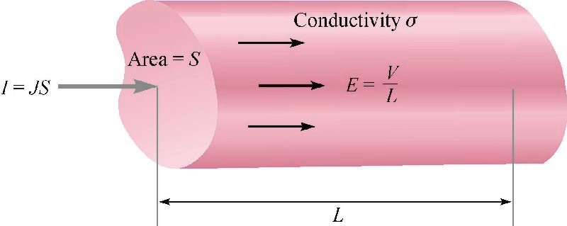
Resistance and Ohm's law
- Cylindrical material with constant cross section

Slide 20
Example
Copper wire of 1-mm diameter and 1-m length. 1 V applied between both ends
Resistance = 0.0216 ohm
Current density = 5.9 x 10⁷A/m²
Electron drift velocity = 4.3 mm/s

Slide 21
Resistance of materials with non-uniform cross section

Slide 22
Examples: resistance calculation

Slide 23
Examples: resistance calculation

Slide 24
Caution in Unit Change
- Example 1:
ρ = 10 Ω m = 10 Ω 100 cm = 1000 Ω cm. Wrong!
ρ =1 Ω cm = 1 Ω 0.01 m = 0.01 Ω m. Correct!
- Examplex 2:
σ = 1 μS/cm = 10⁻⁶ S/(0.01m) = 10⁸ S/m

Slide 25
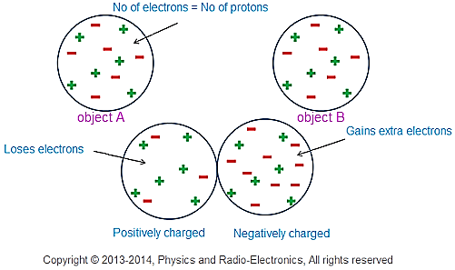
4. Charge Continuity
Charge conservation law
- The net charge of an isolated system will remain constant.

Slide 26
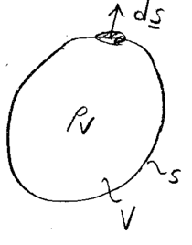
Charge continuity
- The total current flowing out of a closed surface is the negative of rate of change
of charge inside the surface

Slide 27
Charge relaxation
- Charge density decays exponentially in a conductor.

Slide 28
5. Coding Example
Example 1:
Given a line charge at (0, 0, z_{s}) m with charge density 4πε₀ (C/m) with a < z_{s} < b and
a field point P(x, 0, z) m,
1) find the potential V at P by numerical integration
2) find the potential V at P by formula
(Answer)

Slide 29
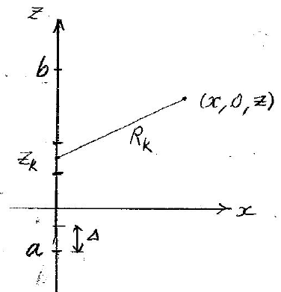
5. Coding Example
# EM-Lec6-Example 1: Electric potential due to a finite line charge
# Given a line charge at (0,0,zs) m with charge density 4pi*epsi0 (C/m)
# with a<zs<b and a field point P(x,0,z) m,
# 1) find the potential V at p by numerical integration
# 2) find the potential V at p by formula
from math import *
while True:
a,b=map(float,input('Line charge at (0,0,zs) with zs from a to b: a, b (m) =').split())
x,z=map(float,input('Field point at (x,0,z): x, z (m) =').split())
n=int(input('Number of sampling points for numerical integration: n='))
dzs=(b-a)/n
zs=a-0.5*dzs
sum=0
for i in range(n):
zs=zs+dzs
r=sqrt((x-0)**2+(0-0)**2+(z-zs)**2)
sum=sum+1/r
sum=sum*dzs
print(' Numerical integration: V(x,z)=',sum)
rb= sqrt((x-0)**2+(0-0)**2+(z-b)**2)
ra=sqrt((x-0)**2+(0-0)**2+(z-a)**2)
v=log((rb+b-z)/(ra+a-z))
print(' Formula: V(x,z)=',v)
'''
Line charge at (0,0,zs) with zs from a to b: a, b (m) =
-1 2
Field point: x, z (m) =
3 4
Number of sampling points for numerical integration: n=
10
Numerical integration: V(x,z)= 0.658584955797933
Formula: V(x,z)= 0.6586505454927757
Line charge at (0,0,zs) with zs from a to b: a, b (m) =
'''

Slide 30
