Slide 1
Lecture 7 Electrostatics (4)
1. Dielectric Polarization
2. Method of Images
3. Electrostatic Energy
4. Boundary Conditions
5. Coding Example

Slide 2
1. Dielectric Materials and Permittivity
Dielectric polarization
- Negative/positive charges oriented toward the positive/negative electrode
- Charges do not move freely in the material but reoritented.
Fig. Polarization in materials [www.pcbdirectory.com]

Slide 3
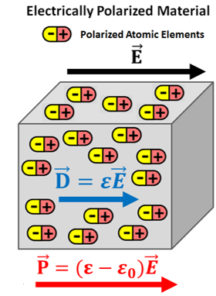
Permittivity of dielectric materials

Slide 4
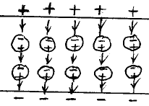
Dielectric polarization - Feynman's model
- A model of a dielectric: small conducting spheres embedded in an idealized
insulator
- Charging of conducting spheres: top = negatively charged, bottom = positively
charged
- Polarization (= charge separation) increases electric flux density in the material.

Slide 5
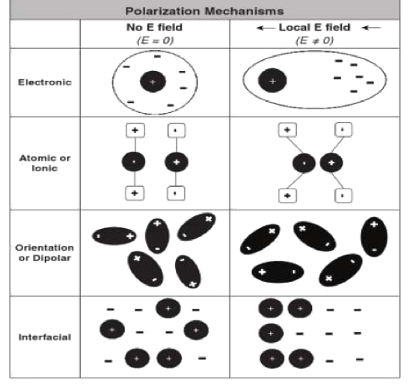
Polarization mechanisms in dielectric materials
- Electron displacements
- Ion displacements
- Dipole orientation
- Space (interfacial) charge displacements
Fig. Polarization mechanisms [Knowles]

Slide 6
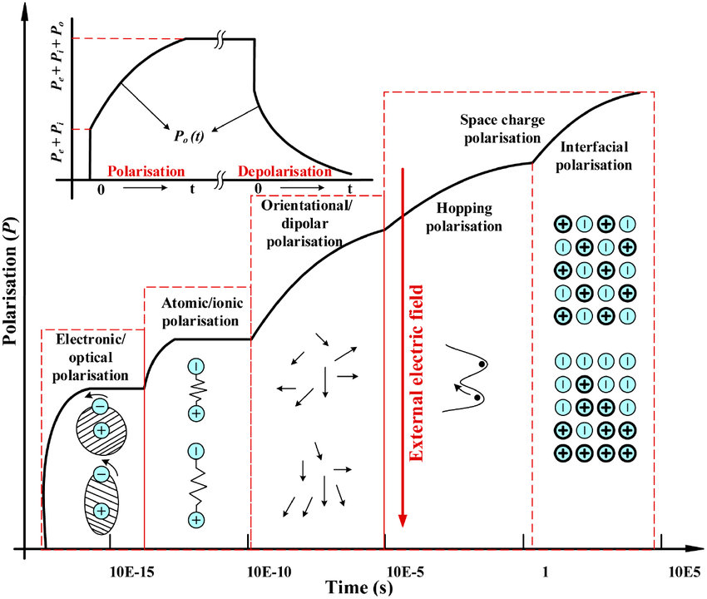
Time constant of electric polarization
- Electric polarization: due to many different processes
- Polarization process: has a time constant (relaxation time)

Slide 7
Polarization charge density
- The effect of polarization is modelled using charge densities.
- Polarization charges cannot move around. → Bound charges

Slide 8
Electric flux density in dielectric materials

Slide 9
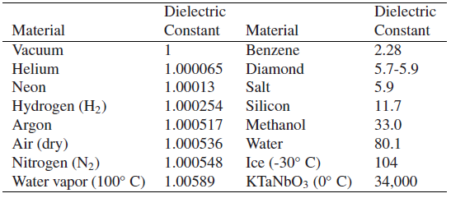
Permittivity of dielectric materials

Slide 10
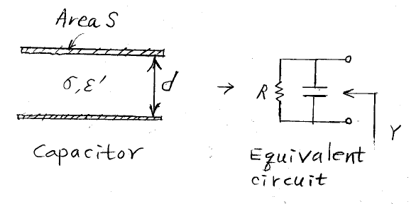
Dielectric loss

Slide 11
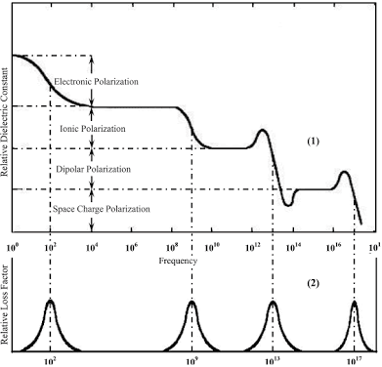
Permittivity dispersion: frequency response

Slide 12
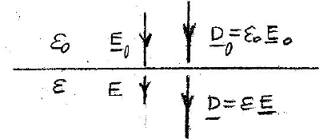
Example: dielectric in an external field

Slide 13
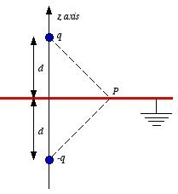
2. Method of Images

Slide 14
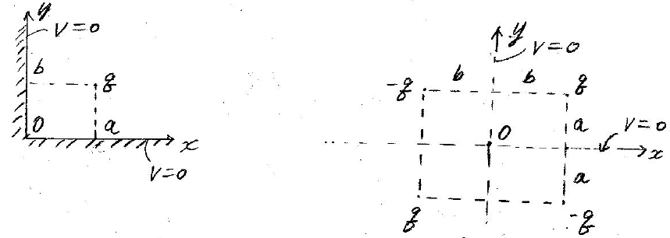
Example: a point source in a right-angle conductor

Slide 15
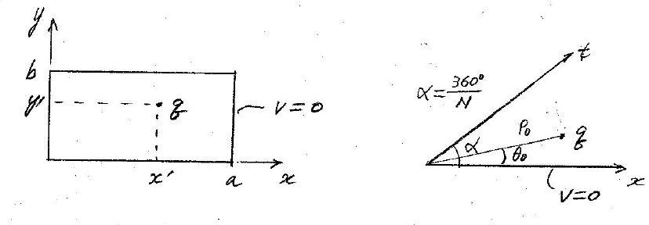
Example: problems requiring an infinite number of images

Slide 16
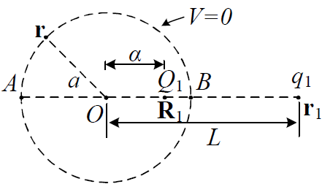
Example: a point charge outside a conducting sphere

Slide 17
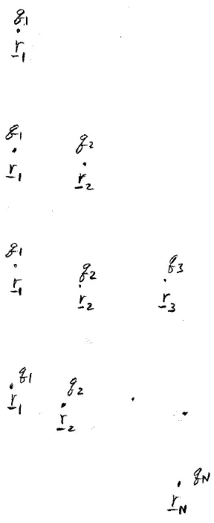
3. Electrostatic Energy
Energy stored in N point charges

Slide 18
3. Electrostatic Energy
Energy stored in distributed charges

Slide 19
Electrostatic energy in terms of electric field

Slide 20
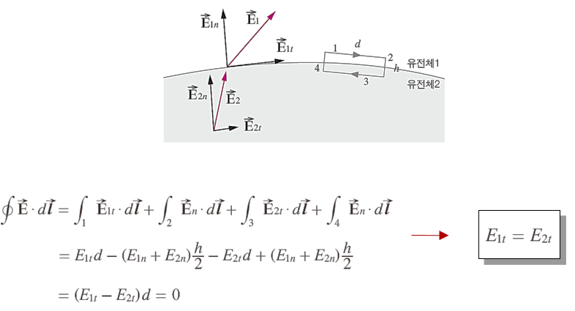
4. Boundary Conditions
Boundary conditions on a dielectric interface

Slide 21
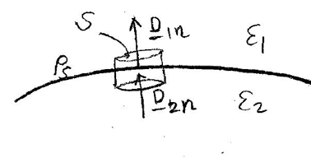

Slide 22
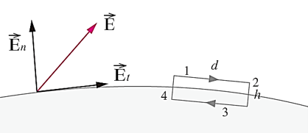
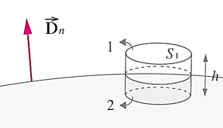
Boundary conditions on a dielectric-conductor interface

Slide 23
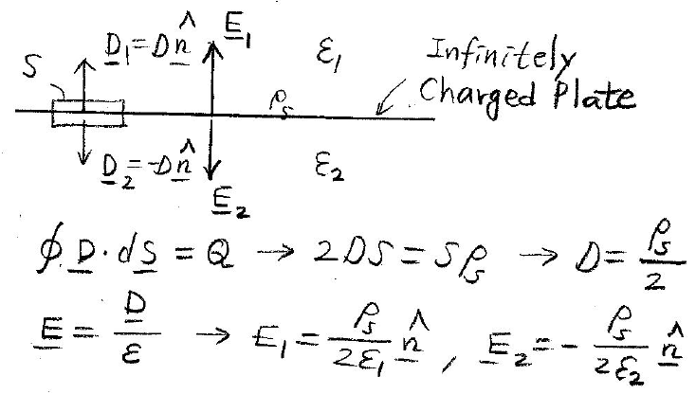
Example: infinite charged plate

Slide 24
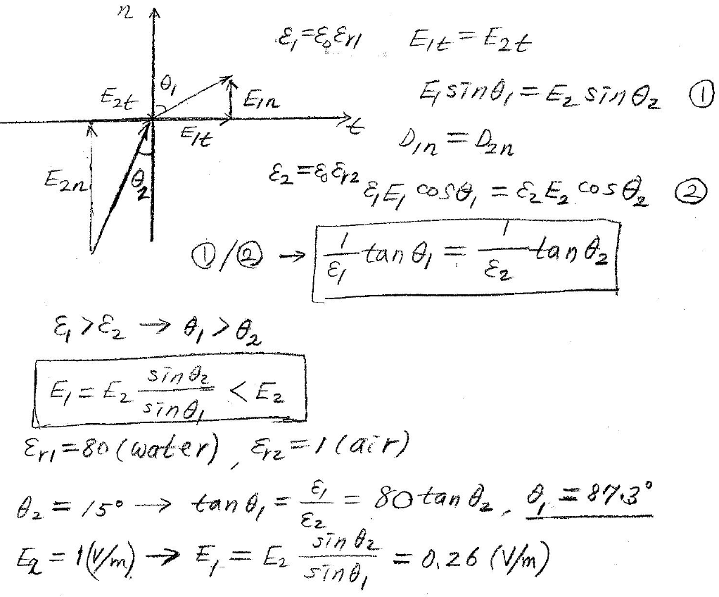
Example: angles of electric field lines on a dielectric interface

Slide 25
5. Coding Example
Example: angles of electric field lines on a dielectric interface
Write down a Python code for the stored energy for N point charges.
Input data:
N : number of point charges
qi (C), (xi, yi, zi) m : i-th point charge and position
Output data:
W (J): stored energy

Slide 26
# Lecture 7 - Python coding example: Stored energy in n point charges
# Input data:
# n = number of point charges (maximum 100)
# qi = charge (C) of the i-th charge
# (xi,yi,zi) = position (m) of the i-th charge
# Output data:
# w = stored energy (J)
from math import *
e0=8.853e-12;pi=3.141593
x=[0]*100;y=[0]*100;z=[0]*100;q=[0]*100
while True:
n=int(input('Number of point charges='))
for i in range(n):
print('For charge no.',i)
q[i]=float(input('Charge: q(C)='))
x[i],y[i],z[i]=map(float,input('Position: x,y,z(m)=').split())
w=0
for i in range(n):
sum=0
for j in range(n):
if(j == i):
continue
else:
sum=sum+q[j]/sqrt((x[i]-x[j])**2+(y[i]-y[j])**2+(z[i]-z[j])**2)
w=w+q[i]*sum
w=w/(4*pi*e0)/2
print('Stored: W(J)=',w)

Slide 27
'''
Number of point charges=
3
For charge no. 0
Charge: q(C)=
1e-10
Position: x,y,z(m)=
1 1 3
For charge no. 1
Charge: q(C)=
2e-4
Position: x,y,z(m)=
3 -1 1
For charge no. 2
Charge: q(C)=
4e-10
Position: x,y,z(m)=
4 1 -4
Stored: W(J)= 0.00018318585243
Number of point charges=
'''

Slide 28
